Slide 1
Panel:
Adaptation Examples in the Detroit Region
Moderator: Katie Grantham, SEMCOG
Panelists:
  Fai Foen, Greening of Detroit
  John Hartig, Great Lakes Institute for Environmental Research, University of Windsor
  Kegan Schildberg, Huron-Clinton Metropolitan Authority

Slide 2
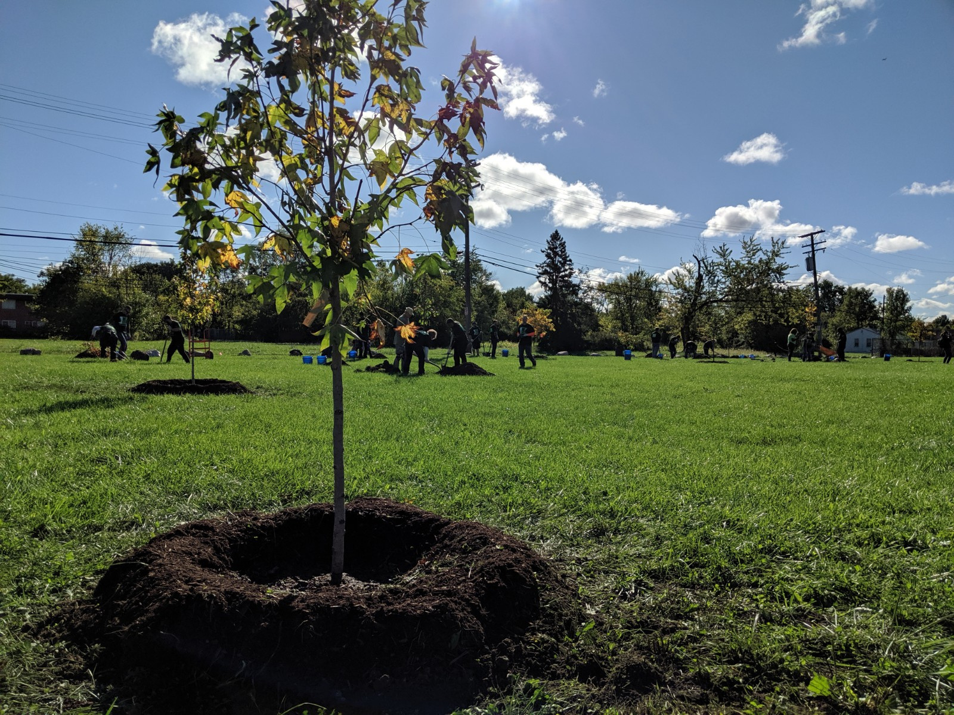

Your Neighborhood Forest Series:
Ecological Rehabilitation in the Floodplain: Eliza Howell Park
Fai Foen, The Greening of Detroit
January 27, 2021
Climate Change Adaptation in the Detroit Region’s Urban Forest

Slide 3
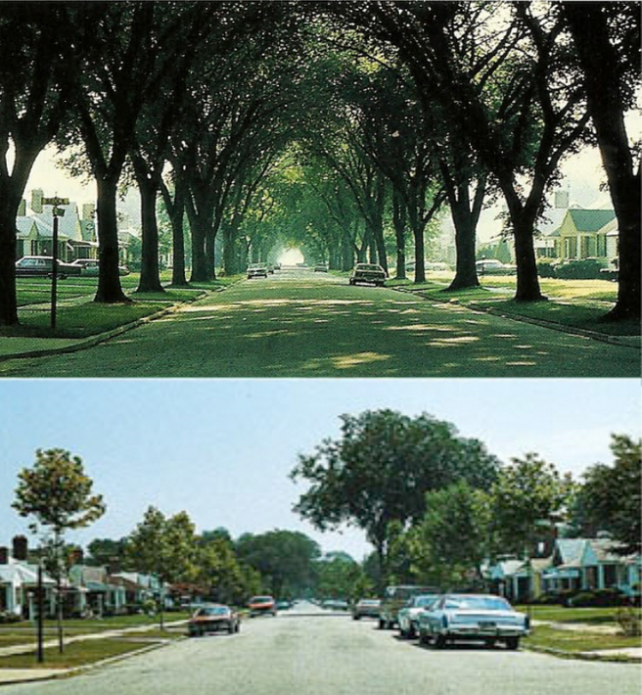
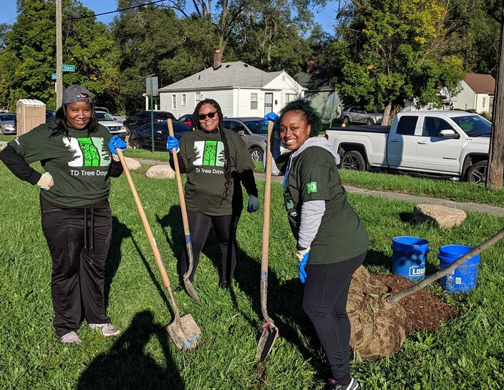
About Us
The Greening of Detroit
  FOUNDED IN 1989
    We are a community focused environmental non-profit, founded as a volunteer-led tree planting organization in response to Dutch Elm Disease and Emerald Ash Borer.
  CORE MISSION
PHOTO CREDITS: JACK H. BARGER, USDA FOREST SERVICE.
    Our mission focuses on improving the quality of life for and with Detroit residents, by increasing Detroit’s urban forest and providing Adult and Youth workforce training.
  133,000+ TREES PLANTED IN 30 YEARS!
Notes:
Our organization started over 30 years ago as a volunteer-led tree planting organization in response to Dutch Elm Disease and Emerald Ash Borer. Today our programs focus on improving the quality of life for and with Detroit residents, by increasing Detroit’s urban forest and providing Adult and Youth workforce training.
Today, I’m presenting our work in Ecological Rehabilitation in the Floodplain: Eliza Howell Park.

Slide 4
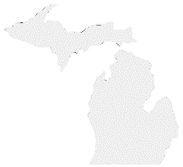
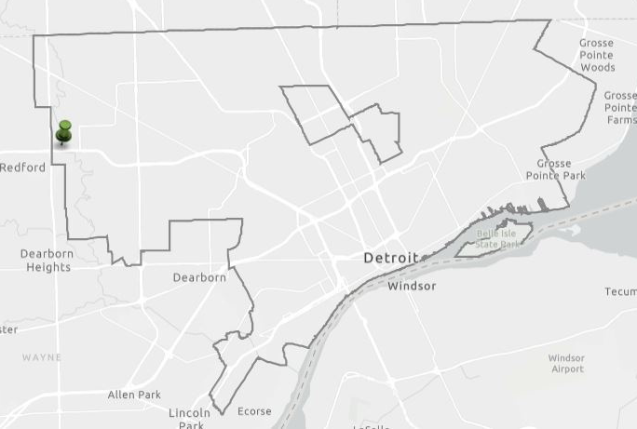
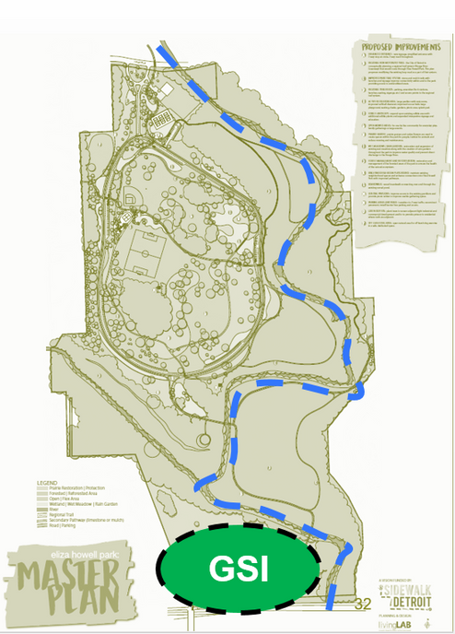






Eliza Howell Park Infiltration Basin
  Project : Shallow, infiltration basin designed to capture road runoff to improve
  water quality in the Rouge River.
  Partners : City of Detroit, OHM Engineering.
  Location : South end of the 250 acre park, in Northwest Detroit.
Eliza Howell
Park
Downtown
Notes:
Funded in 2017 by an EPA/GLRI grant for watershed management implementation and installed in 2020.

Slide 5
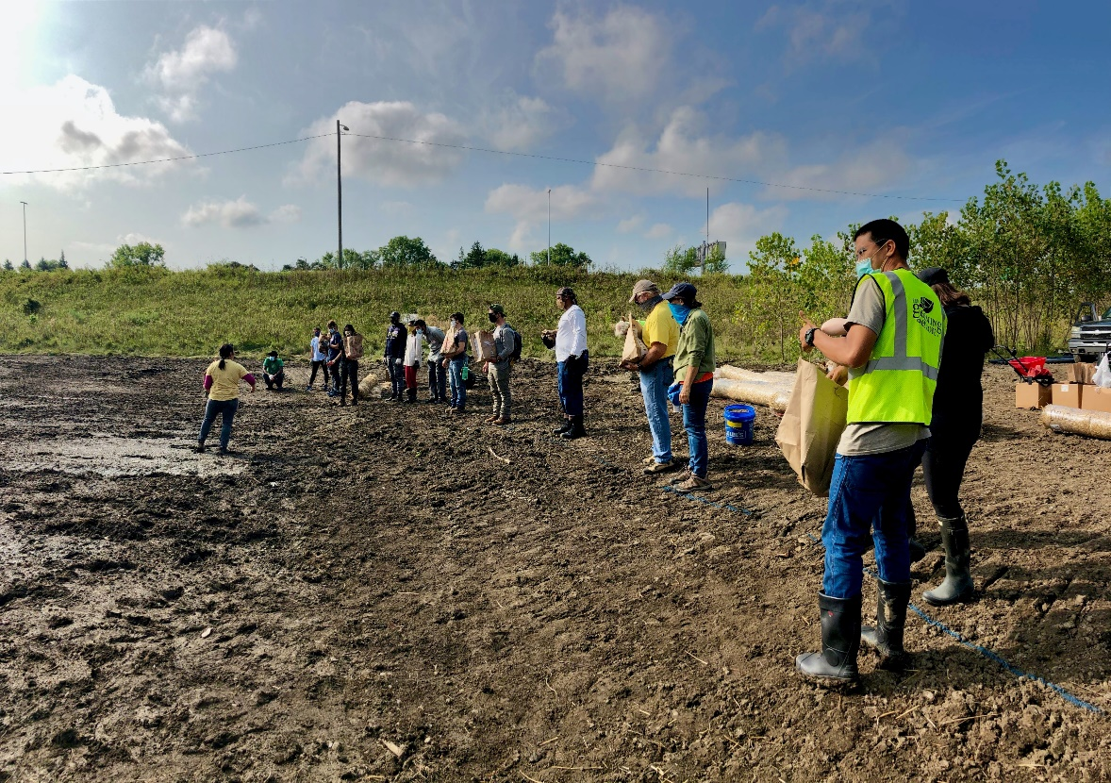
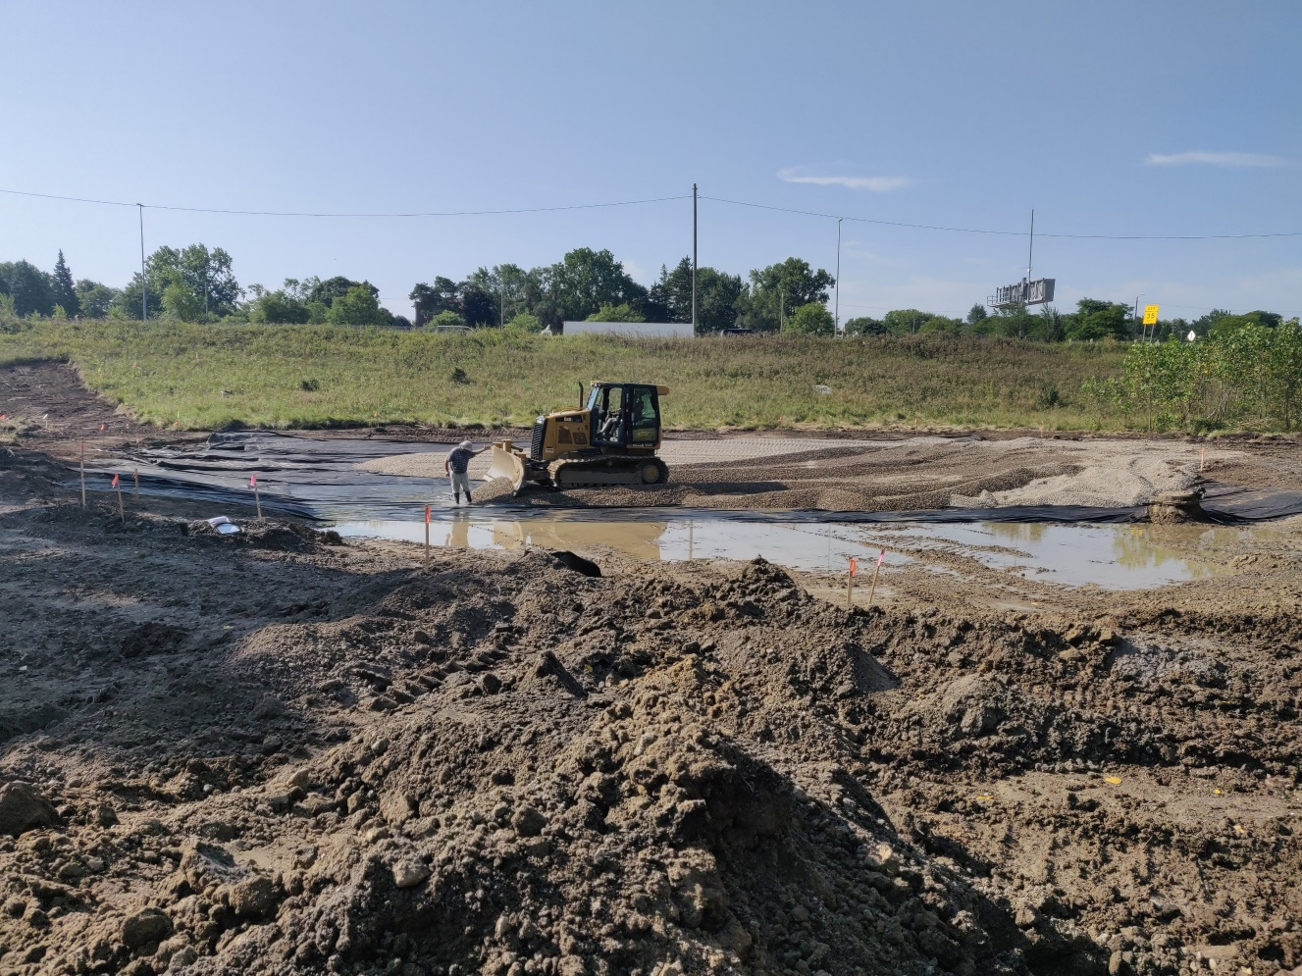
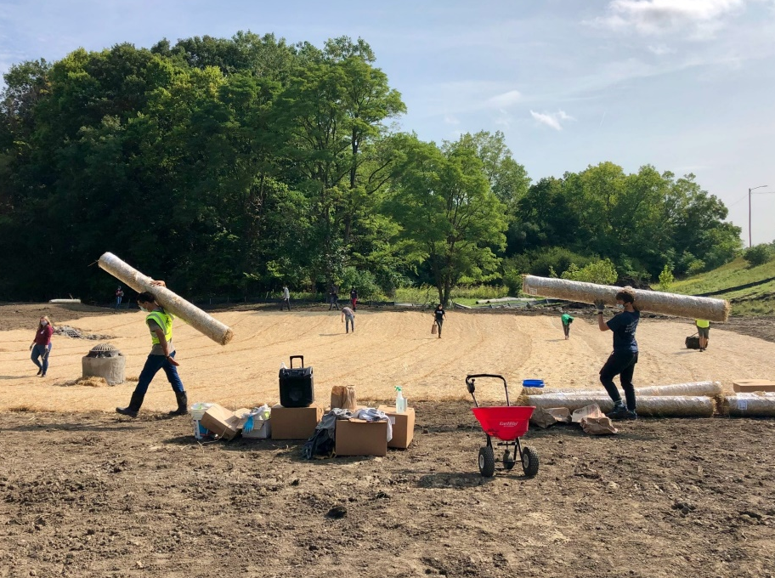
Eliza Howell Park Infiltration Basin
  Constructed in 2020, the basin* captures stormwater runoff from the I-96 service drive and surface flow from the park.
  Manages up to 112,000 gallons
  of stormwater per rain event.
  Native trees and plants specified for the project.
  Community planting events key to outreach and engagement.
  *Infiltration Basin = A type of green stormwater infrastructure (GSI)

Slide 6
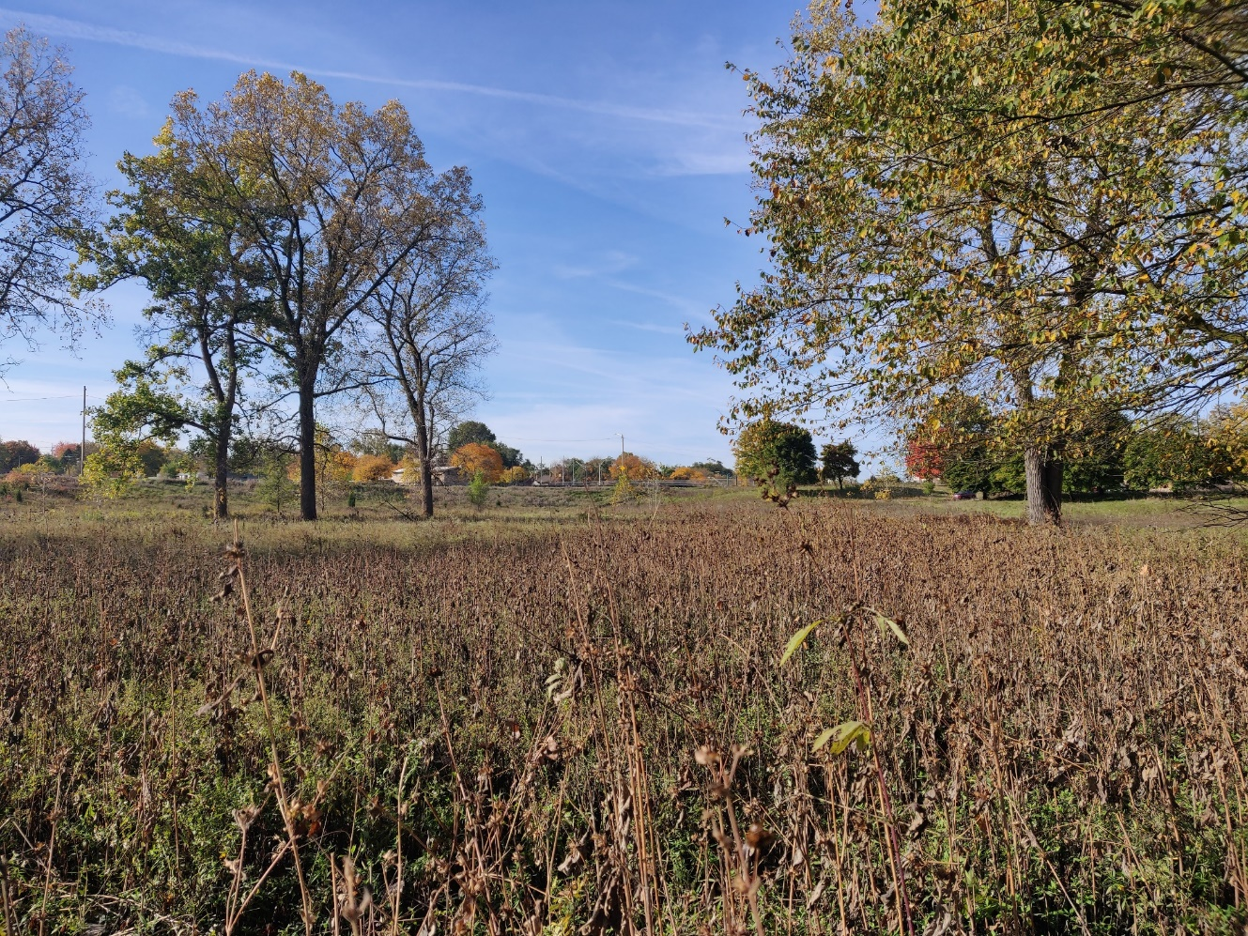
Climate Change Impacts
    Increased and frequent rain events
    Because of the location in the floodplain, chose site adapted species based on pre-settlement ecosystems.
  2. Increased temperatures
    More difficult and expensive to establish young trees, adjusting maintenance plan.
    While there is concern for shifting zones for tree species, we did choose native species that would have a better chance in a natural area, than urban conditions (i.e. street tree).
  3. Potential for increase and variety of pest
  Eliza Howell Park - South
Notes:
Even though the west end of our site looked like this, ….the Rouge River is 200’ feet immediately to the east.
Michigan has lost 4.2 million acres of wetland in the last 200 years.
Pre-settlement 10.7 million acres of wetlands covering more than 17 percent of the state’s total land area.

Slide 7
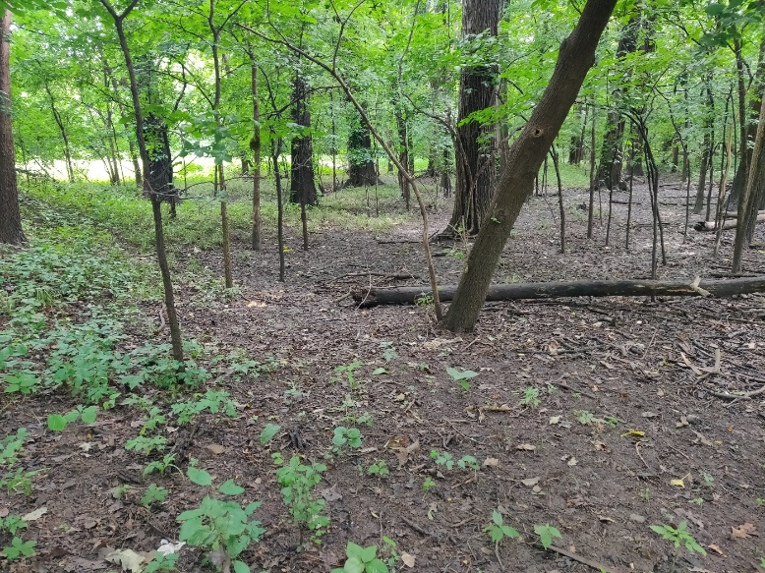
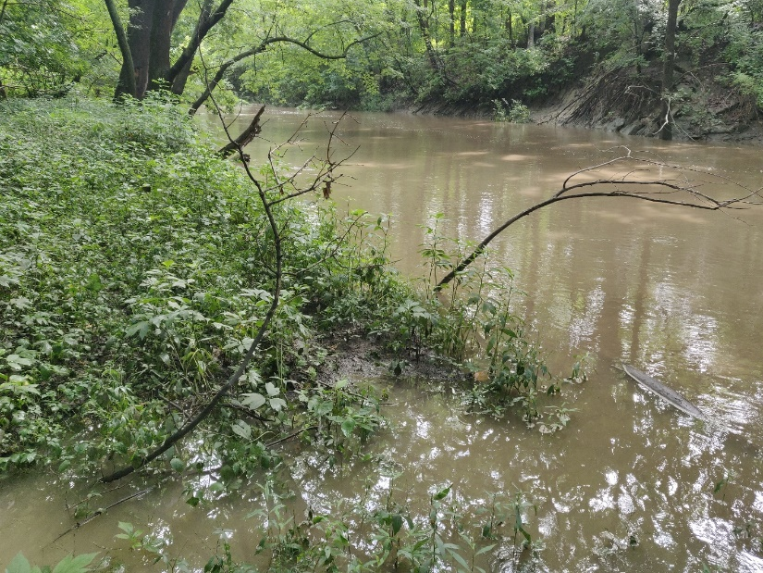
Key Feature: Floodplain
  Natural area in the floodplain of the Rouge River, the most densely populated and urbanized area in Michigan.
  This GSI project increases the holding capacity of stormwater runoff, rehabilitating and increasing this natural function to the area.
  Floodplain forest, July 2019
  Rouge River within 200’ of site
Notes:
As a natural area in the floodplain of a heavily urbanized river, the ecological rehabilitation drove this project.
Unlike ecological restoration, this site would likely never be restored to a landscape before European settlers, but we could reference the ecosystems to rehabilitate the functions of this area and ensure better species selection that would adapt to site conditions.
-----------------------
Because while the west end of our site looked like this, ….the Rouge River is 200’ feet immediately to the east.
It was very important to be able to work closely with our engineering partner. If Patrick is here, just want to give you a shout out.
Beside making sure the site was designed and built to safely flood and infiltrate within 48 hours, OHM provided their contour elevation information.
Read elevations, or change text to more relevant for workshop

Slide 8
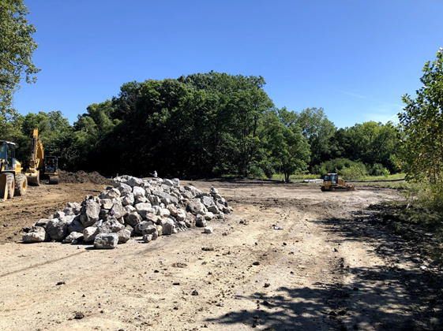
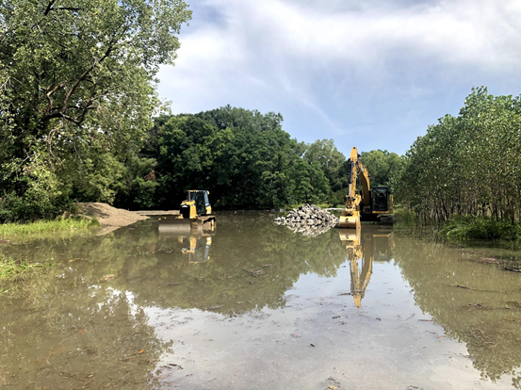
Key Feature: Floodplain
  August 28, 2020
  September 3, 2020
Notes:
As a natural area in the floodplain of a heavily urbanized river, the ecological rehabilitation drove this project.
Unlike ecological restoration, this site would likely never be restored to a landscape before European settlers, but we could reference the ecosystems to rehabilitate the functions of this area and ensure better species selection that would adapt to site conditions.
-----------------------
Because while the west end of our site looked like this, ….the Rouge River is 200’ feet immediately to the east.
It was very important to be able to work closely with our engineering partner. If Patrick is here, just want to give you a shout out.
Beside making sure the site was designed and built to safely flood and infiltrate within 48 hours, OHM provided their contour elevation information.
Read elevations, or change text to more relevant for workshop

Slide 9
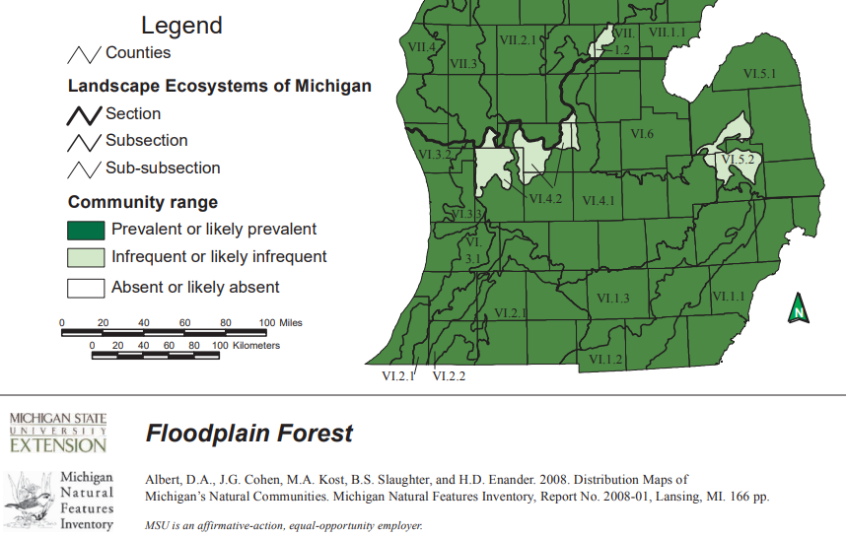
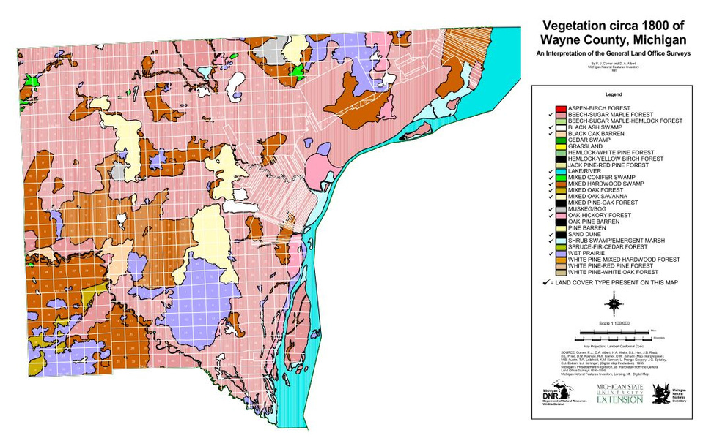
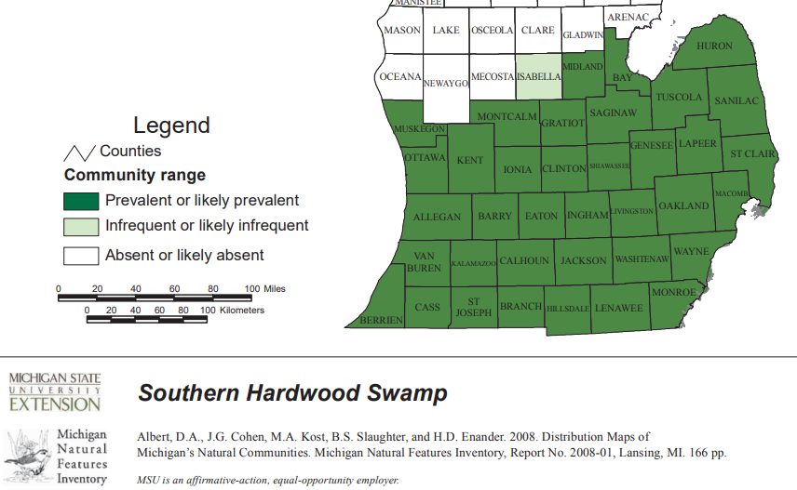
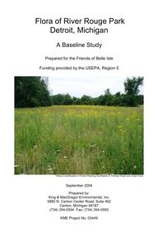
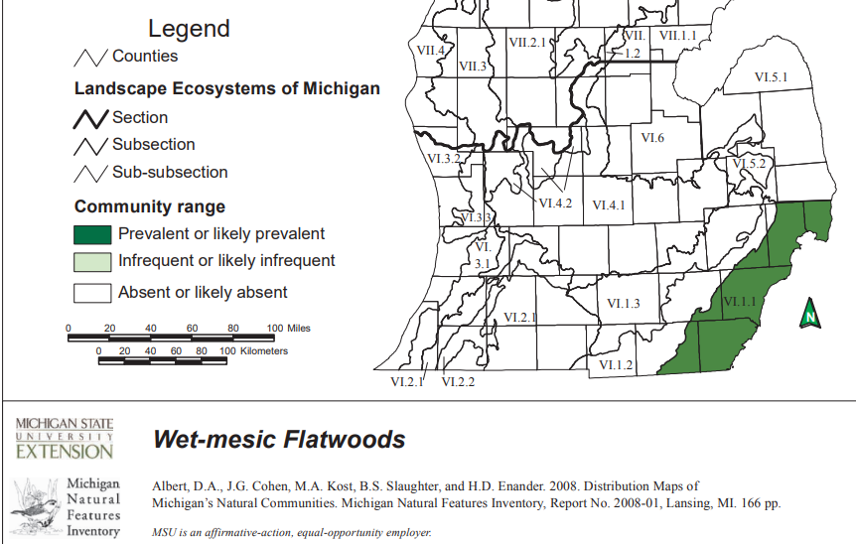
Key Feature: Tree Selection
  The planting design references ecosystems and native tree species that existed here before European settlers altered the landscape – which were adapted to existing site conditions.
    Flood Plain Forest
    Swamp Hardwoods
    Wet-Mesic
  Consulted with staff and online resources of the Michigan Natural Features Inventory (MNFI)
  2004 Flora of River Rouge Park

Slide 10
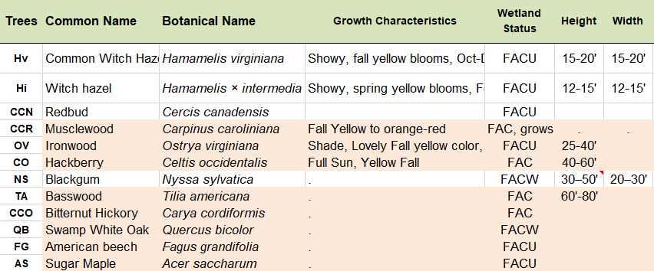
Tree Species
  Trees planted at or Below 600' elevation
  Hackberry
  Swamp White Oak
  Black Gum
  Above 600‘ elevation
  Basswood
  Musclewood
  American Beech
  Sugar Maple

Slide 11
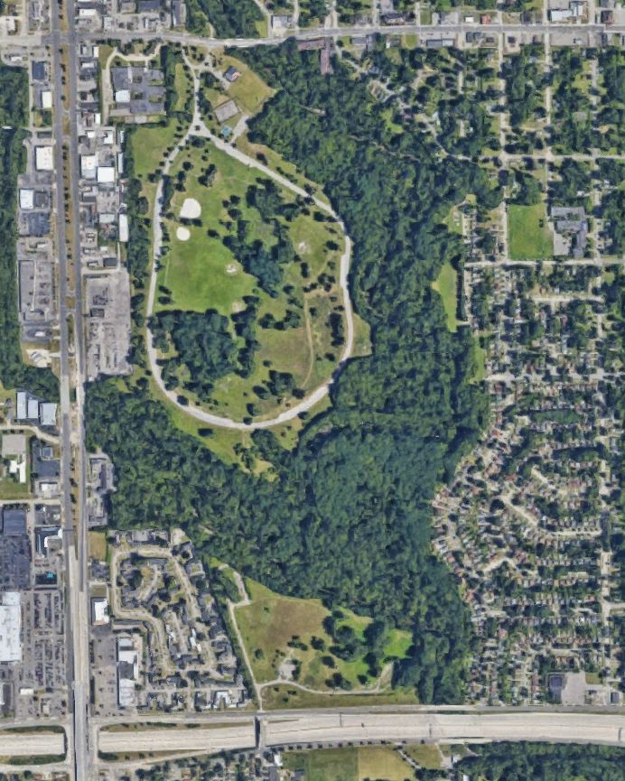
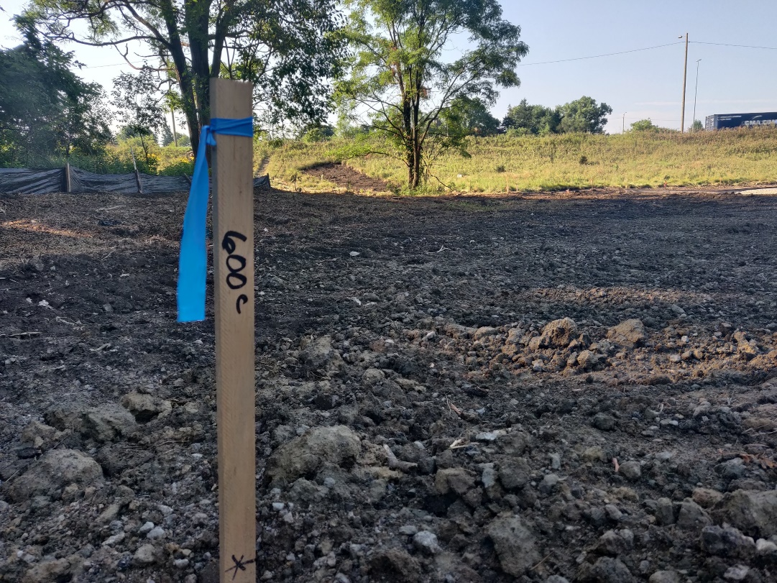
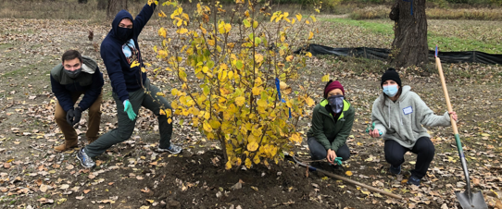
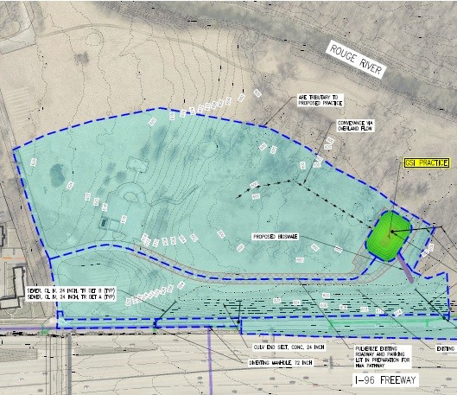
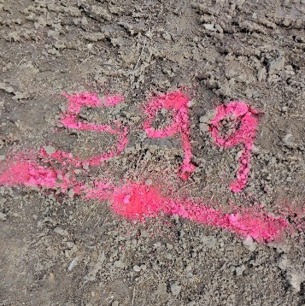
Planting Design for Stormwater Management
  We worked closely with the engineer to understand site elevations in the floodplain to determine planting layout.
  The contractor supported our need to mark out elevations for site layout and volunteer planting event.
  13,000+ sq ft. asphalt parking lot removed.
  50 trees, 144 shrubs, wetland and upland native seed mix planted by volunteers. 200 additional perennials will be planted this year.
Notes:
Tree Species Layout: Our site elevations ranged between 597’-603’ above sea level. 600’ was the transition For general comparison, Detroit’s lowest elevation is 572’ at the Detroit River.
Some of these species are noted to for their vulnerability in a high emissions scenario. Given this is a natural area, rather than highly urbanized street tree setting, we are hedging our bets.

Slide 12
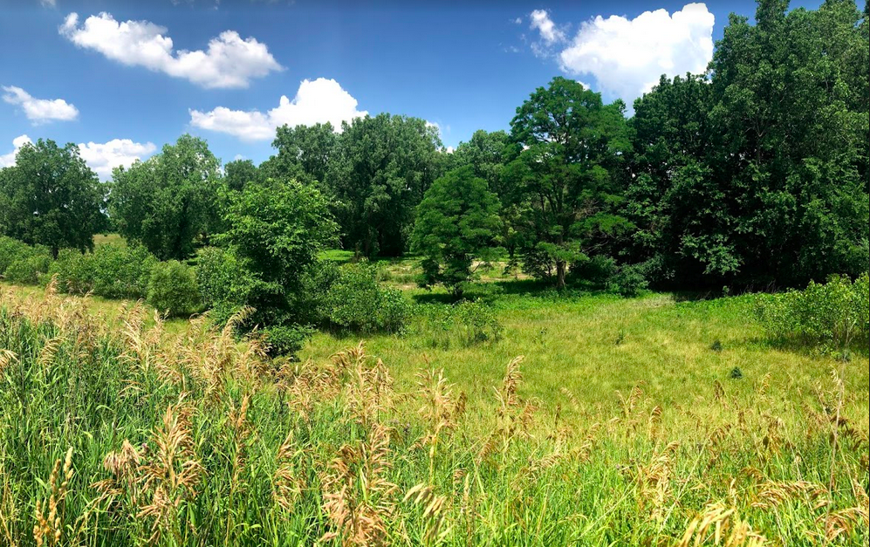
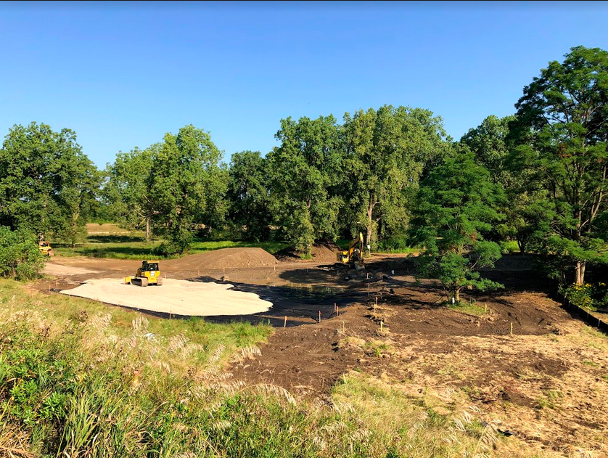
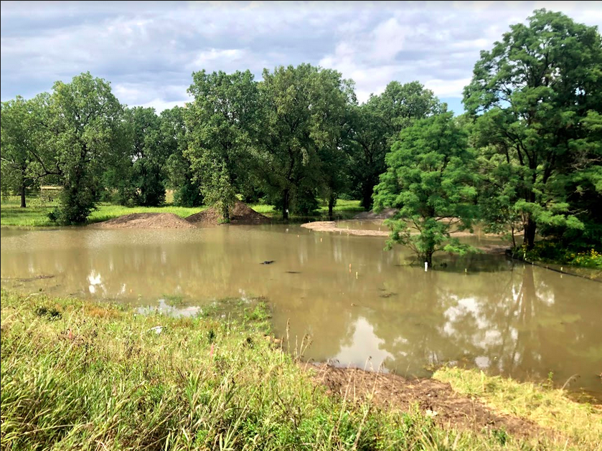
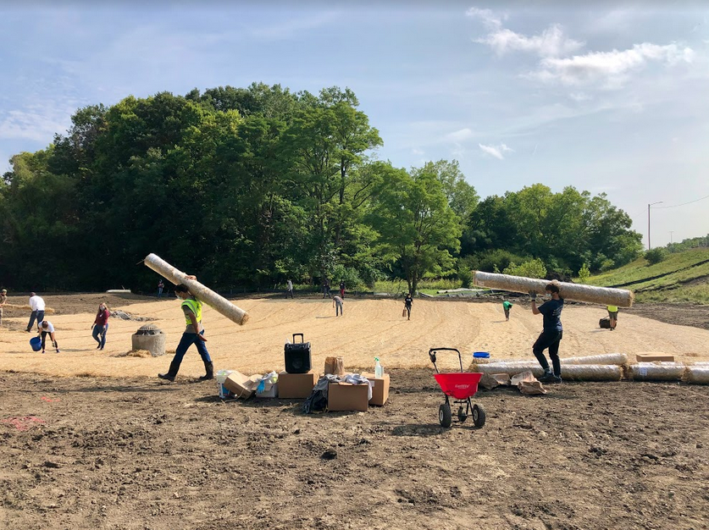
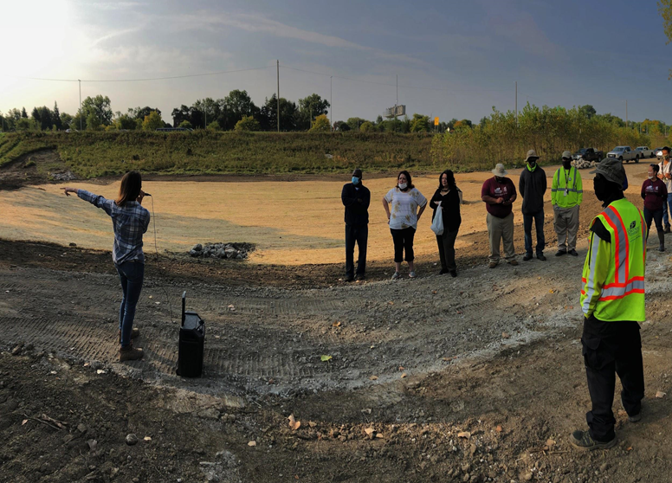
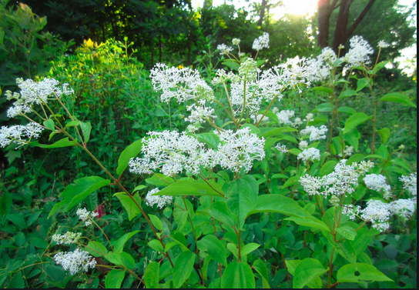
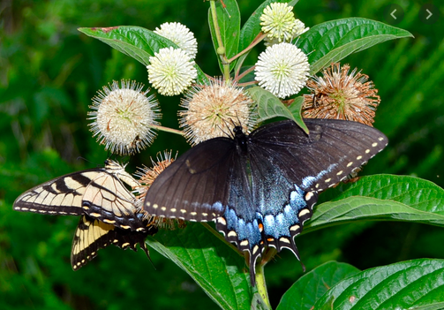
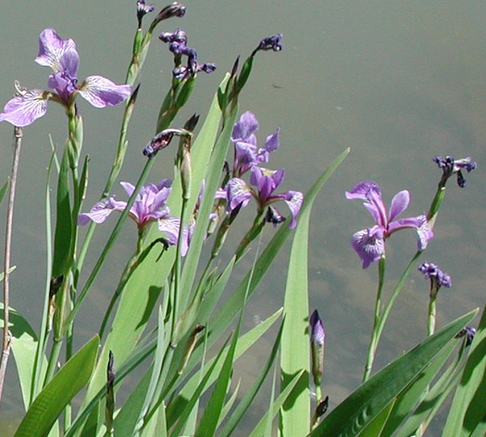
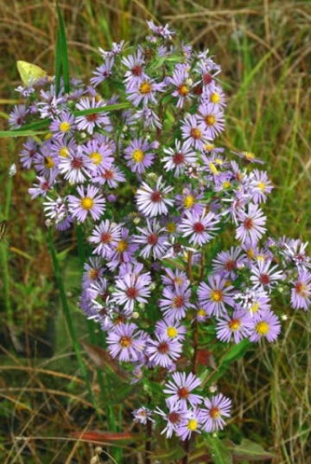
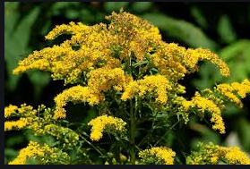
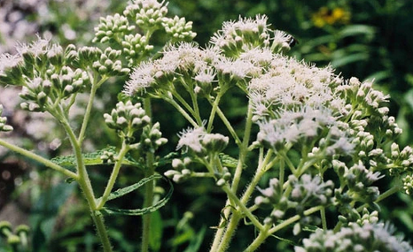
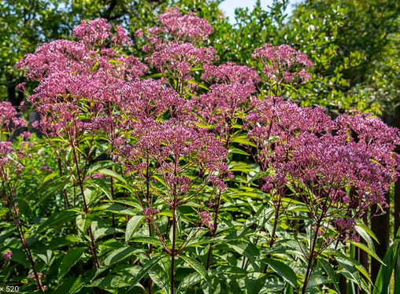
Climate Change Strategies
Species we hope to see blooming this year
Notes:
Climate strategies
Engage people with all aspects of the work we do in community forestry. From collaborating with underresourced community groups to meet their tree planting needs, to identifying neighborhoods with low-canopy cover for resource prioritization, to recruiting volunteers.
Restore and increase tree, forest, and vegetative cover
Choosing native tree species, and those adapted for flooding
And different trees sizes for age diversity,

Slide 13
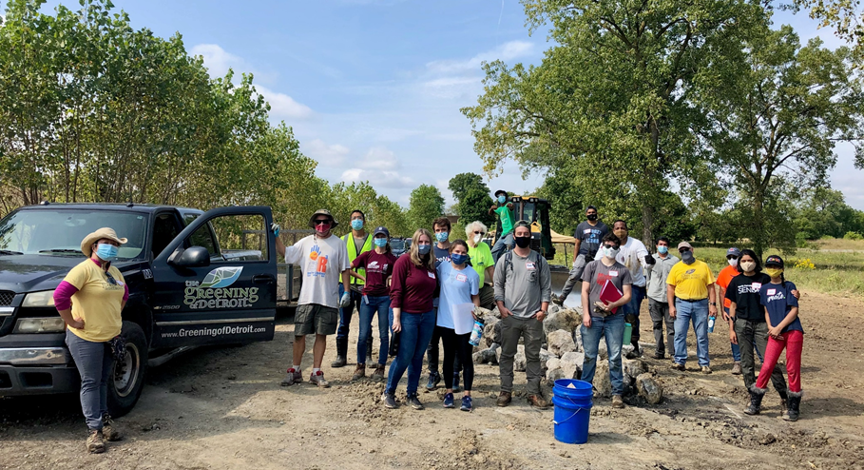
Climate Change Actions
  Maintain watering schedule, especially for upland tree species.
  Plan Crew and Volunteer maintenance days for invasive species.
    Challenge: Becoming more familiar with wetland invasives and respective management practices.
    Scheduling sufficient time to address outbreaks with urgency.
  Provide opportunities for community education, in-person and online.
    Promote mental and social health in face of climate change and the pandemic.
  Eliza Howell Park - South
Notes:
And lots of poison ivy

Slide 14
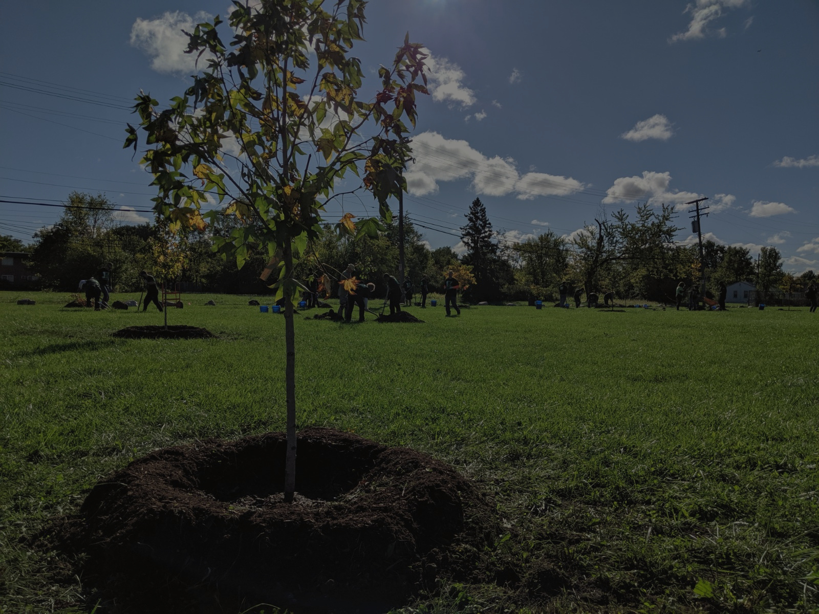
Thank You!
Notes:
Looking at the bigger picture of reforesting Detroit...

Slide 15
Enhancing Climate Adaptation and Resiliency at the Refuge Gateway in Trenton, Michigan
John Hartig, Visiting Scholar, Great Lakes Institute for Environmental Research, University of Windsor
January 27, 2021
Climate Change Adaptation in the Detroit Region’s Urban Forest

Slide 16
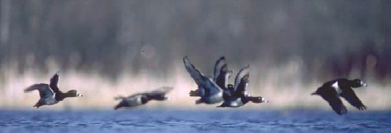

Detroit River International Wildlife Refuge
Signed into law in 2001
  first International Wildlife Refuge in North America
  one of only a few urban refuges
Founded on partnerships for conservation and for the benefit of future generations
A new paradigm for conservation and sustainability

Slide 17
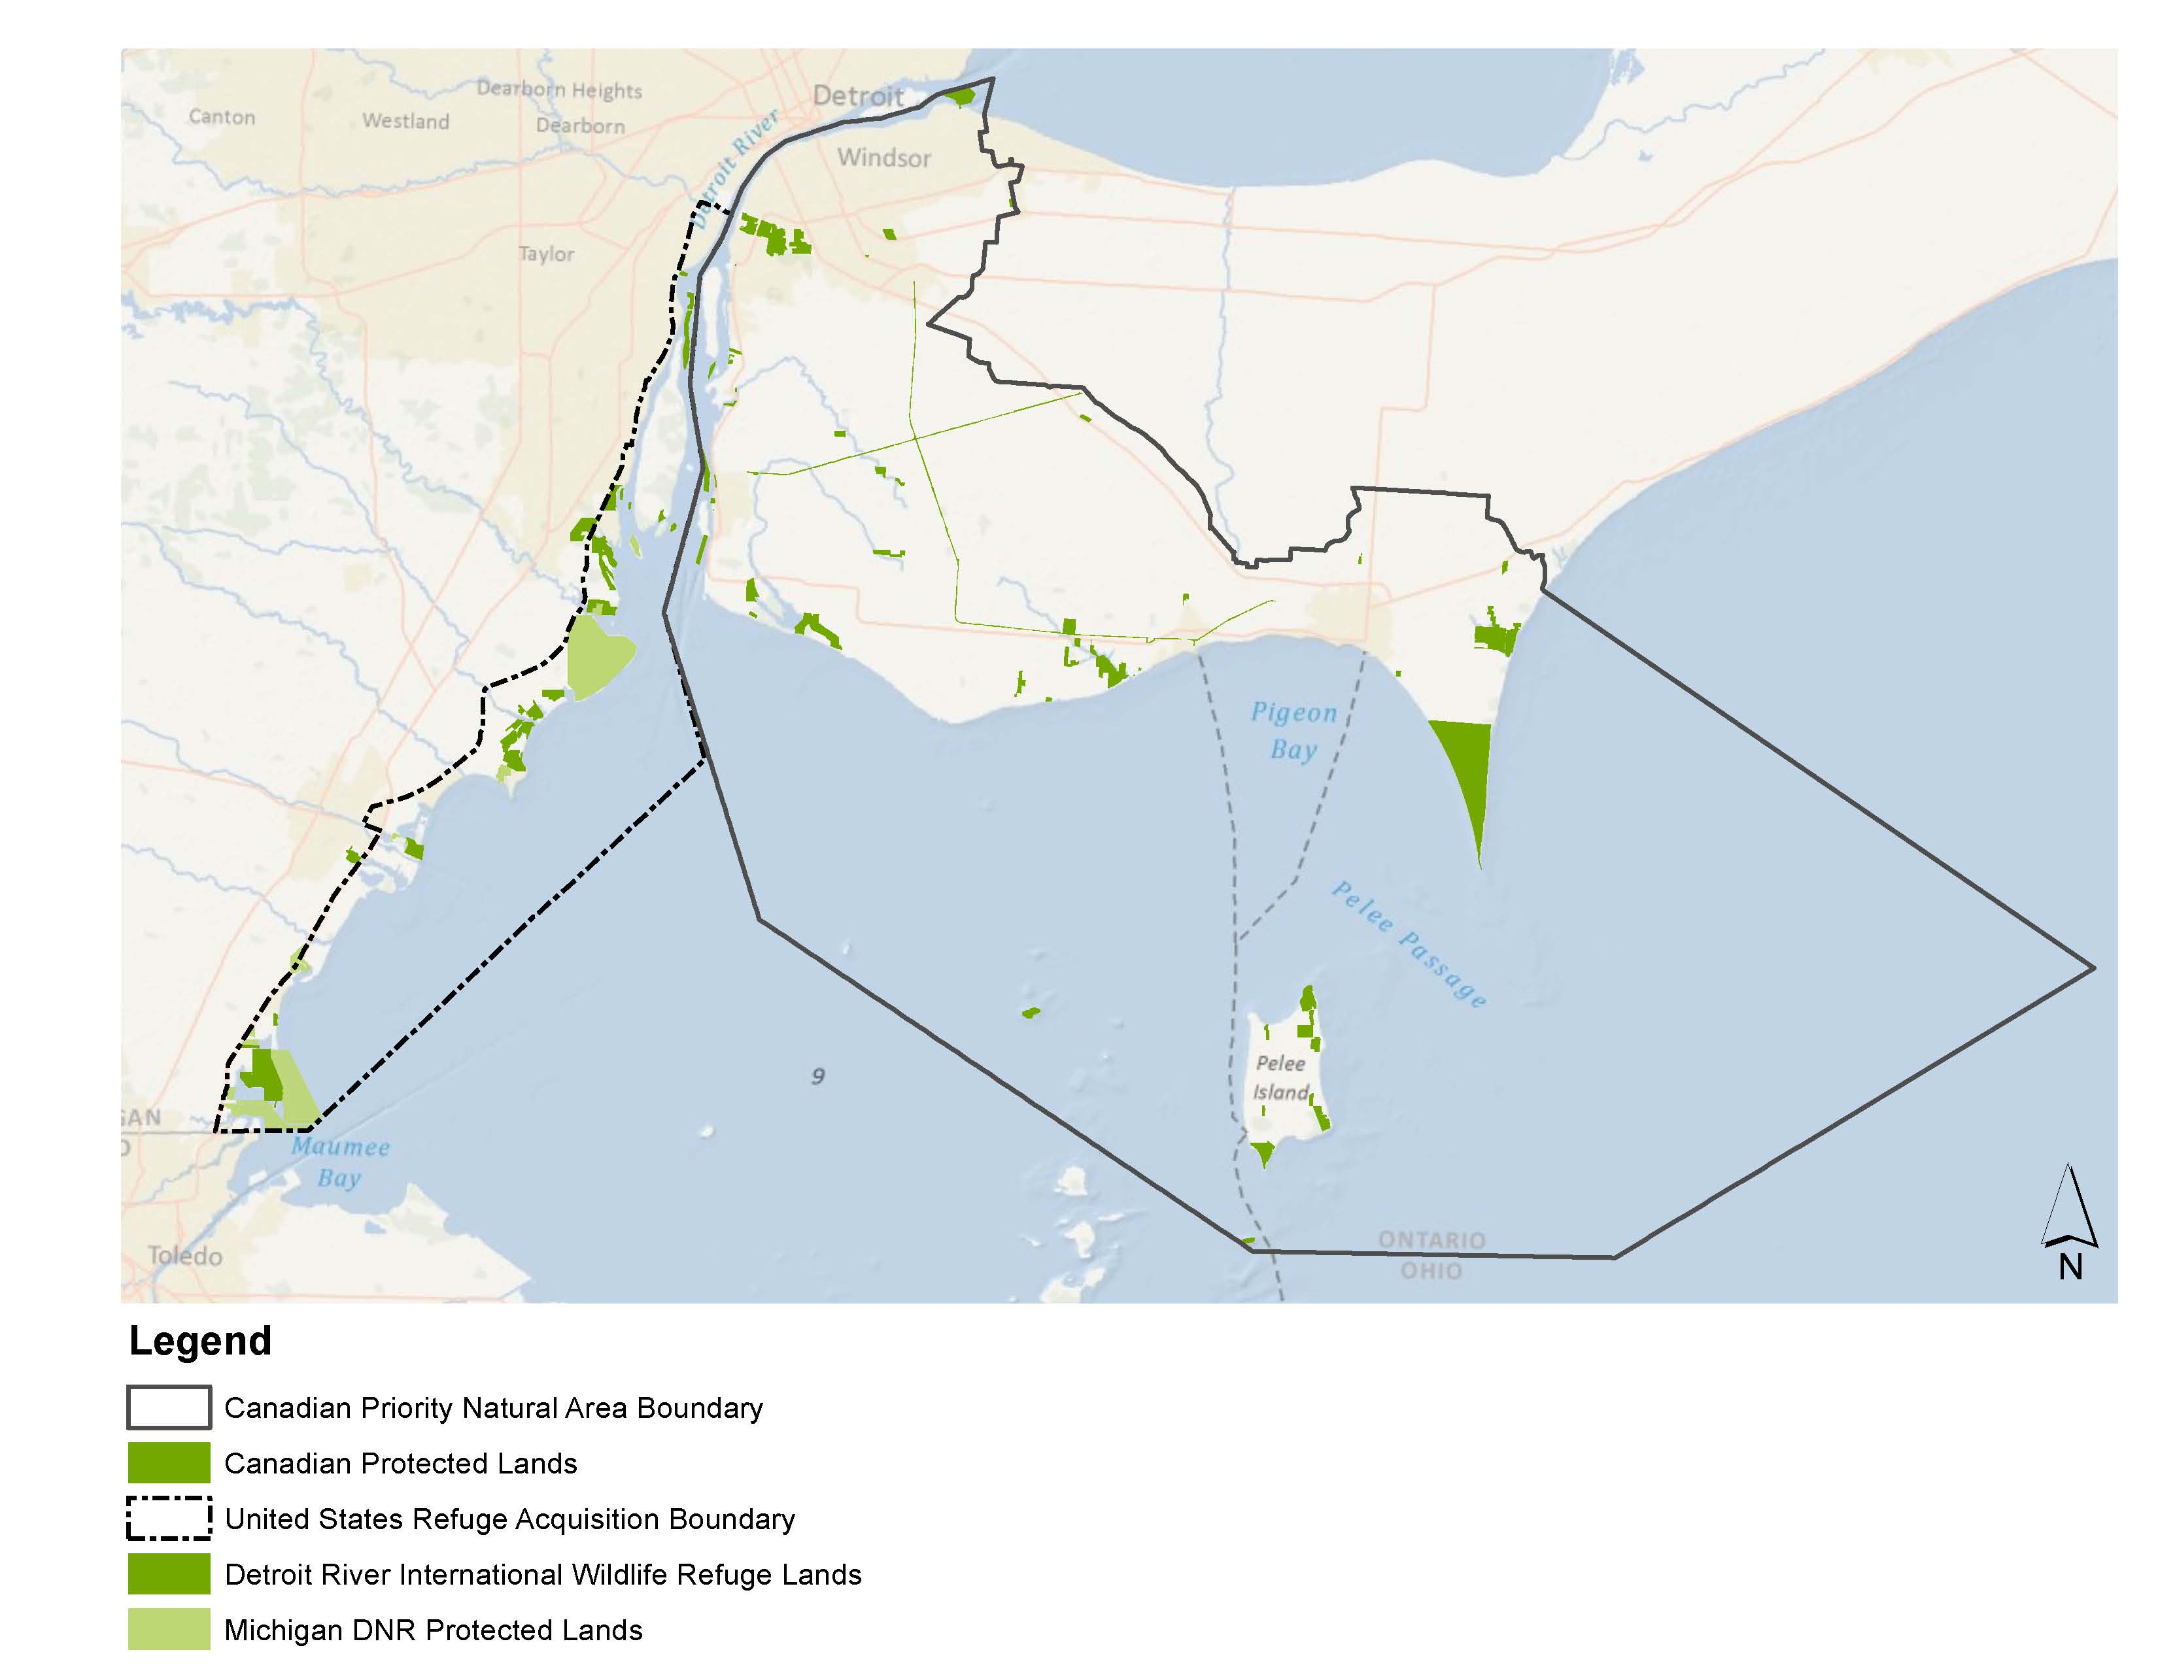

Slide 18
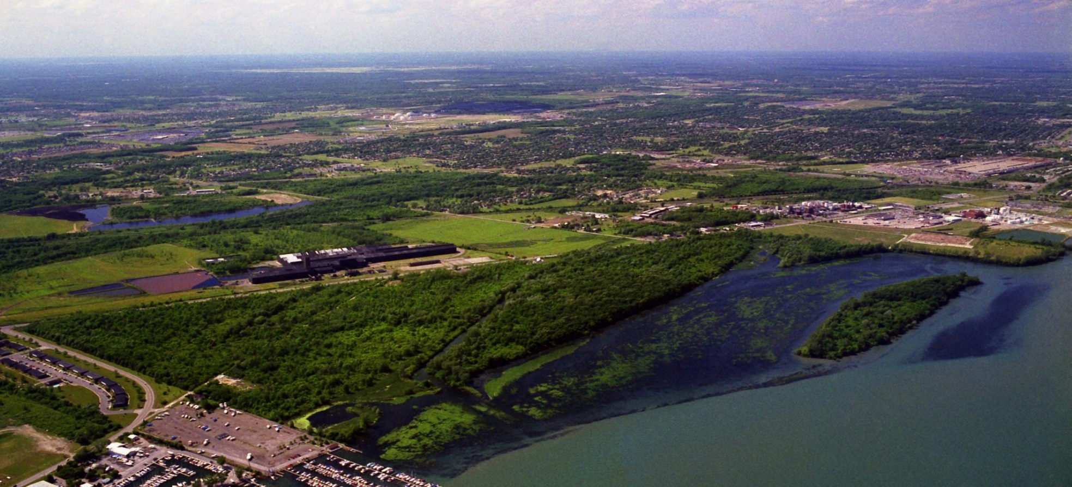
Humbug Marsh – the last mile of natural shoreline on the U.S. mainland of the Detroit River
Notes:
Eight years ago thousands of people, many in this room, were passionate about saving the last mile of natural shoreline on the U.S. mainland of the Detroit River. Your passion made all the difference in preserving Humbug – that became the key catalyst in establishing the Detroit River International Wildlife Refuge.

Slide 19

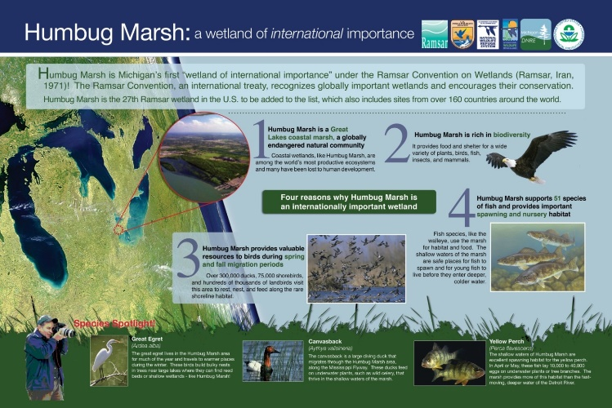
Humbug Marsh Unit – Wetland of International Importance
Over 2,300 Ramsar sites throughout the world
40 in U.S.
One in Michigan

Slide 20
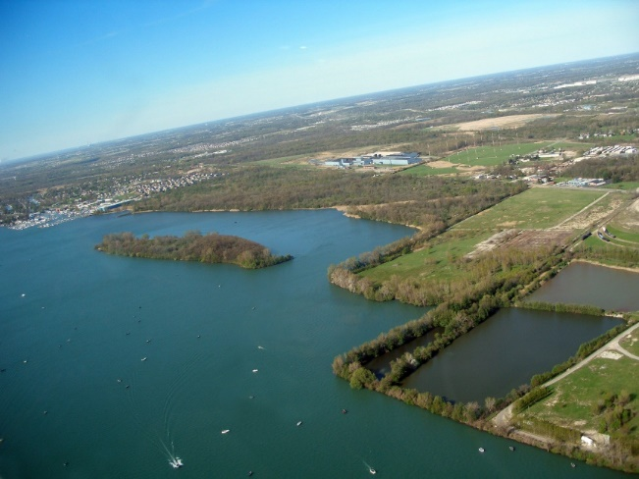
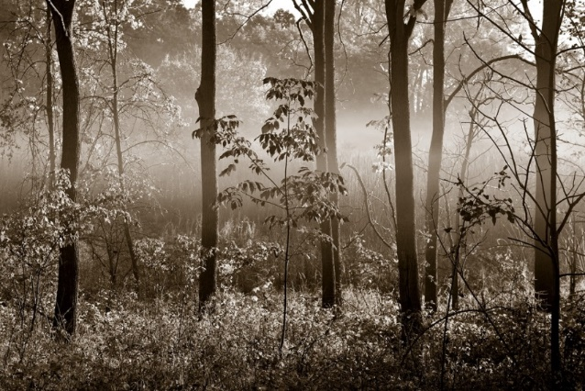
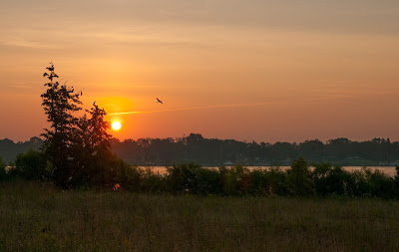
bald eagles
two dragonfly species (Elusive Clubtail and Russet-tipped Clubtail) that are “Michigan Species of Special Concern”
eastern fox snake – threatened in Michigan
a native Michigan orchid called Oval Ladies’-Tresses that is threatened in Michigan (CC of 9)
a rare sedge called the Hairy-Fruited Sedge that is a “special concern” species in Michigan (CC of 8)

Slide 21


Slide 22
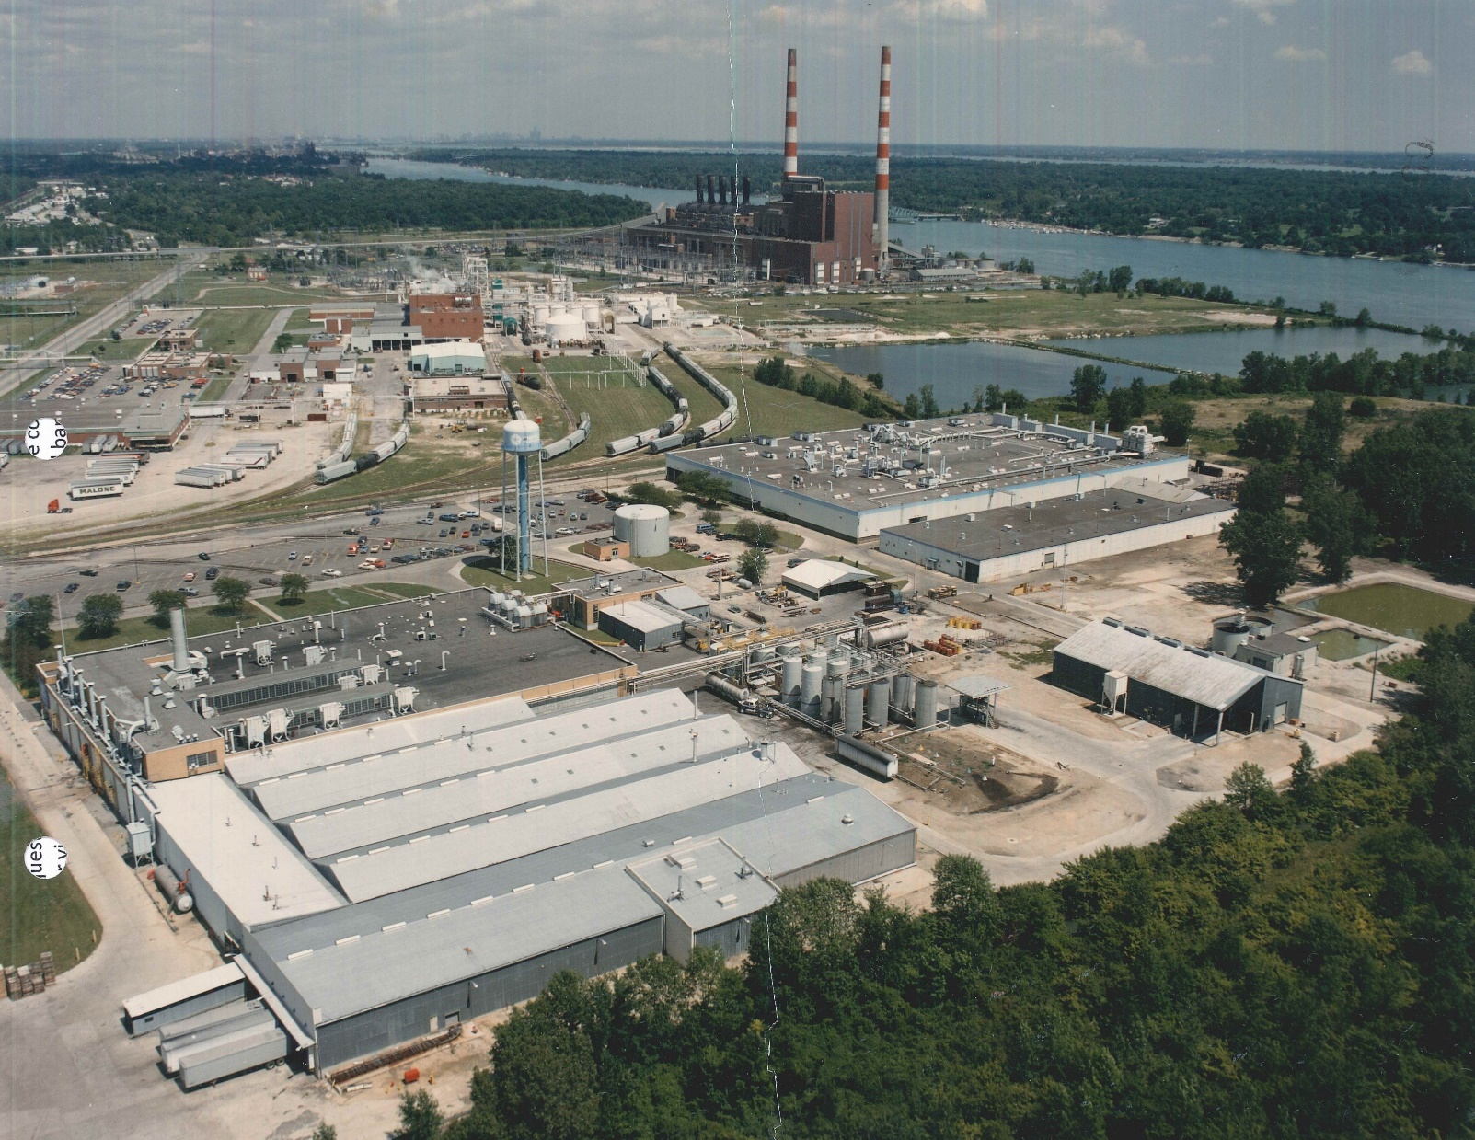

Slide 23
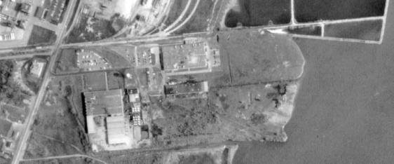

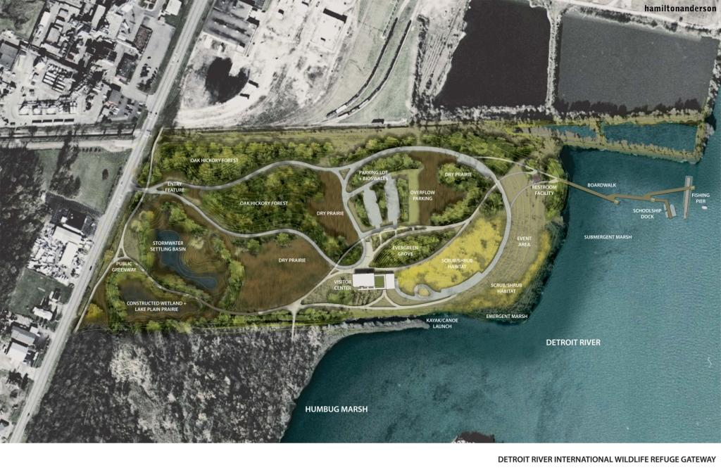
Transformation of an Industrial Brownfield into an Ecological Buffer for Michigan’s only Ramsar Wetland of International Importance

Slide 24
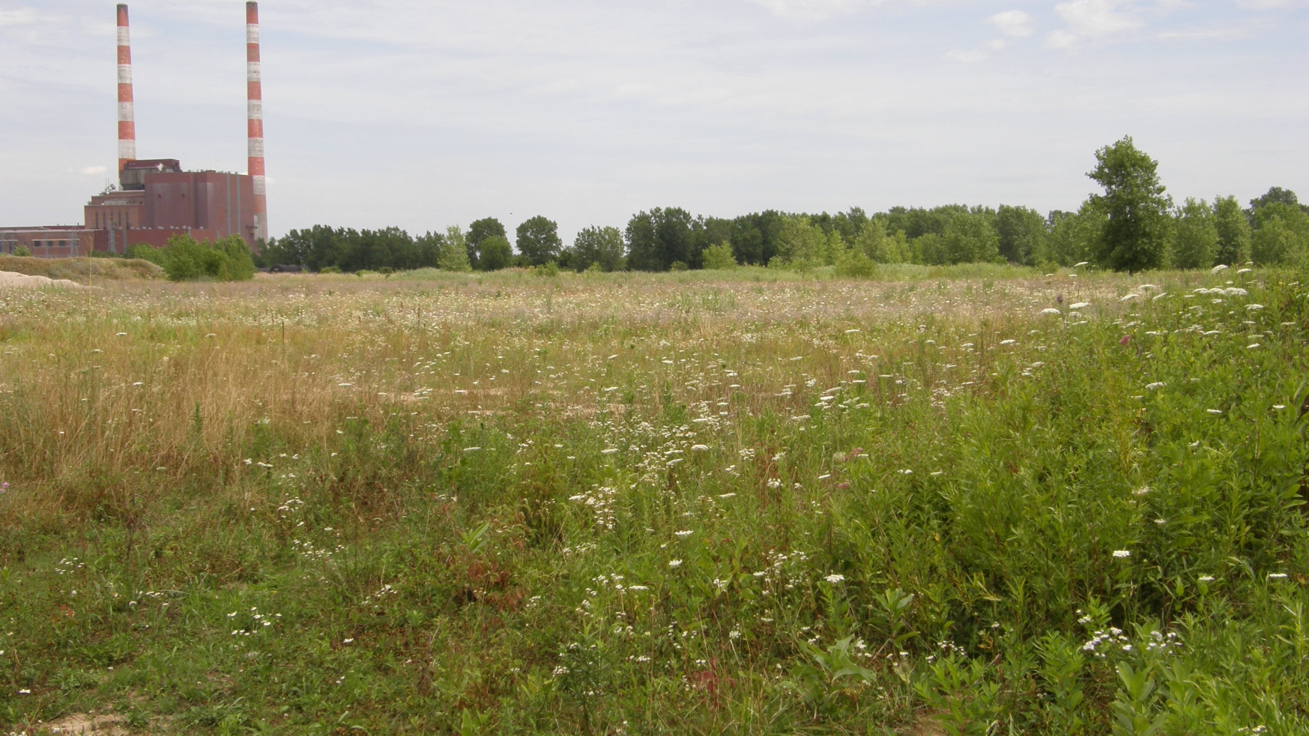
Before cleanup and restoration

Slide 25

Monguagon Wetland System

Slide 26

Over 350 trees plants with volunteers

Slide 27

16 acres of wetlands restored - area has lost 97% of its coastal wetland habitat
25 acres of upland buffer habitat restored
Phragmites controlled on 2.5 mi of shoreline
Invasive species controlled on 50 acres of upland habitats

Slide 28



Slide 29

First Project in the World to Clean Up an Industrial Brownfield Sufficiently to Serve as an Ecological Buffer for a Wetland of International Importance Under the Ramsar Convention

Slide 30


Excellence on the Waterfront Award
2018 Honor Award

Slide 31
Recommendations and Next Steps
Work with local governments and NGOs to incorporate adaptation and resiliency projects into local master plans and efforts
Ensure projects recruit many partners to leverage resources
Start with demonstration projects
Undertake projects that support learning and education, where hypotheses are created and tested using scientific rigor and rationale
Engage citizen scientists, volunteers, university students, and/or researchers in monitoring and post-project monitoring
Measure environmental and social benefits from projects and communicate successes
Advocate for public education and outreach, especially events that highlight project successes and benefits

Slide 32
John Hartig, Visiting Scholar
Great Lakes Institute for Environmental Research
University of Windsor johnhartig1@gmail.com

Slide 33
Huron Clinton Metroparks - Climate Adaptive Management of Forests and Other Natural Areas
Kegan Schildberg, Natural Resources Coordinator - Huron-Clinton Metropolitan Authority

Slide 34

HCMA Fast Facts
Over 25,000 acres
13 parks in five counties: Wayne, Oakland, Macomb, Livingston, Washtenaw
Wide variety of plant communities from costal marshes and floodplain forests to oak savannah and prairie fens.
Active stewardship program since 2006
Primary goal of stewardship program is to protect and restore the Metroparks’ natural areas, preserving the unique biota of the region for generations to come.

Slide 35

Anticipated impacts of climate change on the Metropark’s forests and natural areas

Slide 36




Expected climatic changes in SE Michigan
Four point five to five degree average temperature increase.
25 to 30 less nights below freezing per year.
Three to four more inches of precipitation per year.
One more consecutive dry days per year on average.

Slide 37
Natural communities will benefit or suffer under new climatic regime
Kensington Metropark plant communities and management units
Likely to suffer: Mesic southern forest (beech-sugar maple dominated) and rich tamarack swamp.
Likely to benefit: Dry southern forest (oak-hickory) and oak savannahs.

Slide 38


Invasive species and diseases are likely to benefit from climate change as well.

Slide 39

Adaptation strategies for natural community management at Metroparks

Slide 40


Invasive species and disease mitigation

Slide 41

Restoring native communities that are future climate adapted.
Investing efforts in creating/restoring white oak-hickory (oak wilt) dominated forests and savannahs as well as prairies.
Manage invasive species in high ecological quality communities. Non-climate resilient communities will be shepherd through transition to new community.
Use native plants that have ranges well to the south.

Slide 42

Restoring natural process
Michigan native plants benefit from fire.
Fire helps suppress non native plants.
Fire helps create habitat diversity.
Fire will help promote communities that are expected to do well under projected future climatic conditions.

Slide 43



Maintain a diversity of connected habitats
Don’t aim to restore or maintain just one community type.
Manage to the varying conditions in the field.
Diverse habitats are more resilient (hedging our bets).
Habitat mosaics are beneficial to wildlife.
A variety of communities are more interesting for patrons to explore. (HOT TAKE)

Slide 44



Tools and Resources
MI Flora – UoM Herbarium (https://michiganflora.net/)
Michigan Natural Features Inventory (https://mnfi.anr.msu.edu/)
Huron River Watershed Council – Tree Resilience Toolkit (https://www.hrwc.org/what-we-do/programs/climate-change/climate-resilient-communities/tree-resilience-toolkit/)

Slide 45
Comments or questions?

