Slide 1

Changing Climate in the Detroit Region
Matthew Peters
Northern Research Station
Northern Institute of Applied Climate Science
Delaware, OH
Jan 26, 2021
Notes:
30 min presentation

Slide 2
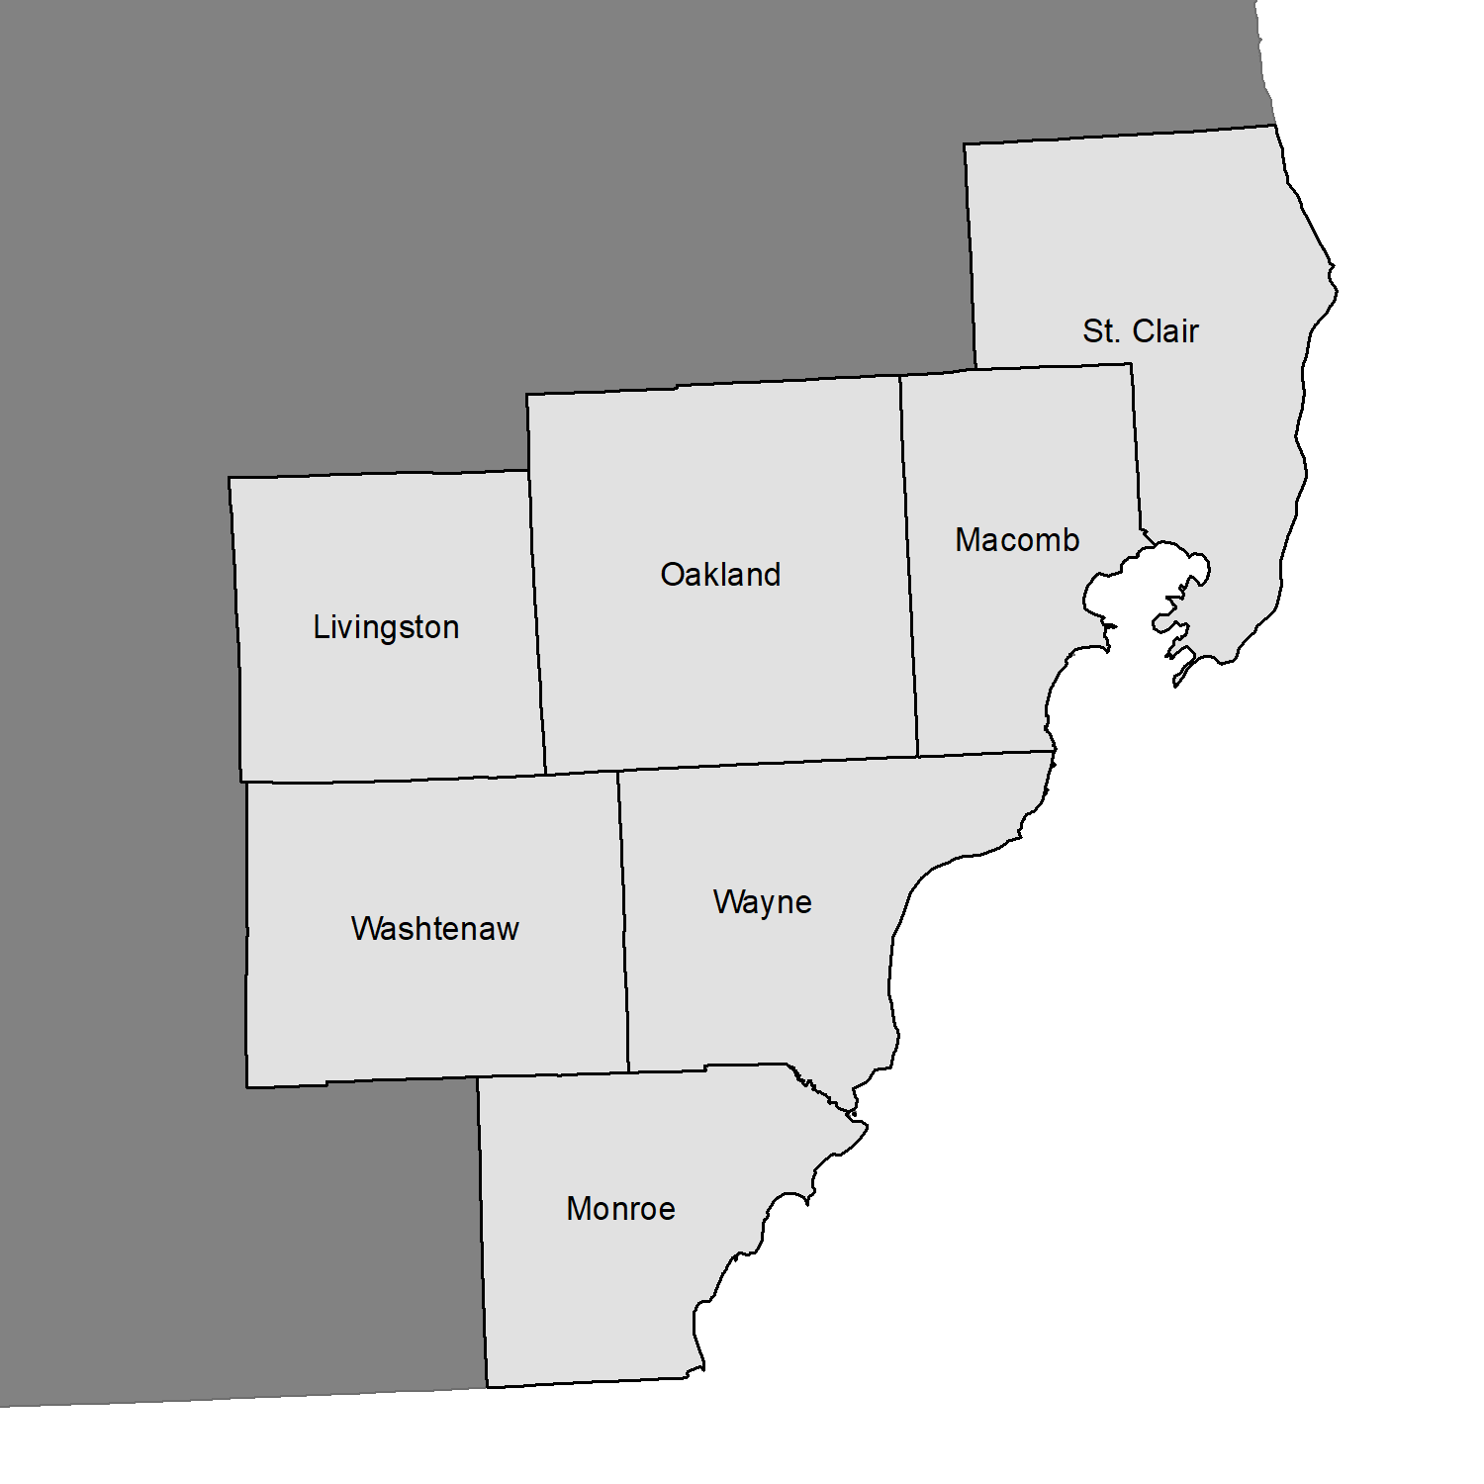
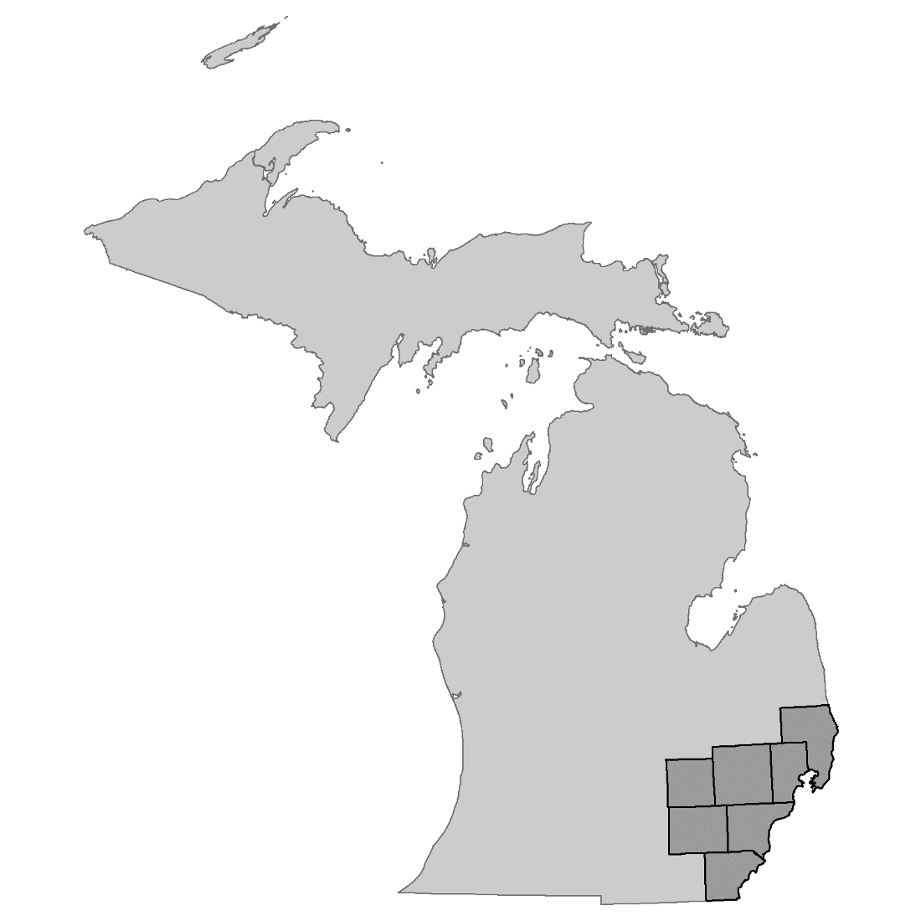
Southeast Michigan
Council of Governments

Slide 3
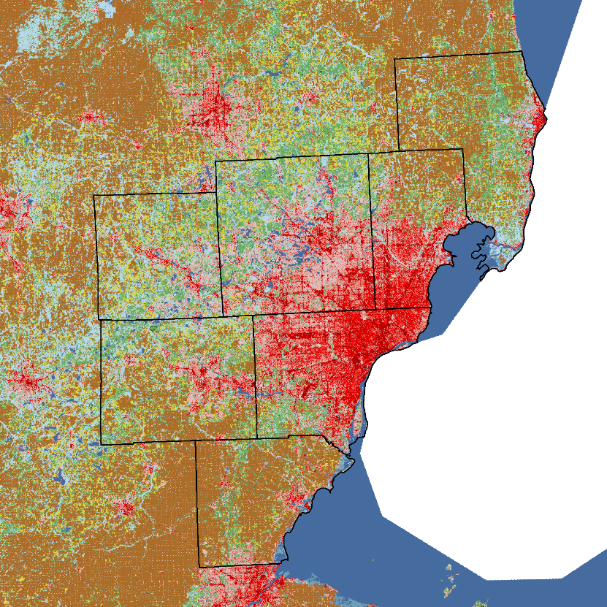



Land Cover/Use
Developed 36.2%
Forested 28.4%
Agriculture 30.3%
 | Open Water | Developed | Barren Land | Forest | Nonforest Vegetation | Agriculture | Wetlands
Livingston | 2.9 | 20.9 | 0.4 | 43.9 | 0.4 | 30.4 | 1.1
Macomb | 1.0 | 52.8 | 0.3 | 18.2 | 0.6 | 26.8 | 0.3
Monroe | 2.5 | 17.2 | 0.8 | 14.6 | 0.6 | 62.4 | 1.9
Oakland | 4.7 | 52.9 | 0.9 | 32.5 | 0.6 | 7.8 | 0.5
St. Clair | 3.8 | 12.4 | 0.2 | 36.6 | 0.7 | 45.0 | 1.3
Washtenaw | 2.0 | 20.6 | 0.3 | 33.9 | 0.5 | 42.0 | 0.7
Wayne | 3.4 | 76.5 | 0.4 | 12.6 | 0.6 | 5.9 | 0.5
SEMCOG | 3.1 | 36.2 | 0.5 | 28.4 | 0.6 | 30.3 | 0.9
 | Open Water | Developed | Barren Land | Forest | Nonforest Vegetation | Agriculture | Wetlands
Livingston | 2.9 | 20.9 | 0.4 | 43.9 | 0.4 | 30.4 | 1.1
Macomb | 1.0 | 52.8 | 0.3 | 18.2 | 0.6 | 26.8 | 0.3
Monroe | 2.5 | 17.2 | 0.8 | 14.6 | 0.6 | 62.4 | 1.9
Oakland | 4.7 | 52.9 | 0.9 | 32.5 | 0.6 | 7.8 | 0.5
St. Clair | 3.8 | 12.4 | 0.2 | 36.6 | 0.7 | 45.0 | 1.3
Washtenaw | 2.0 | 20.6 | 0.3 | 33.9 | 0.5 | 42.0 | 0.7
Wayne | 3.4 | 76.5 | 0.4 | 12.6 | 0.6 | 5.9 | 0.5
SEMCOG | 3.1 | 36.2 | 0.5 | 28.4 | 0.6 | 30.3 | 0.9
Source: MRLC National Land Cover Database 2016

Slide 4


Observed Trends (1960-2019)
Annual Temperatures | 0.4 °F/decade
Minimum Temperatures | 0.4 °F/decade
Maximum Temperatures | 0.5 °F/decade
Annual Precipitation | 0.9 in/decade
Precipitation
Winter
+0.2 in/decade
Temperature
Winter
+0.7 °F/decade
Fall
+0.4 in/decade
Spring
+0.4 in/decade
Fall
+0.3 °F/decade
Spring
+0.5 °F/decade
Summer
+0.1 in/decade
Summer
+0.4 °F/decade
Source: NOAA
www.ncdc.noaa.gov/cag/national/time-series
Notes:
Decadally, annual and seasonal temperatures and precipitation has increased from 1960 to 2019

Slide 5
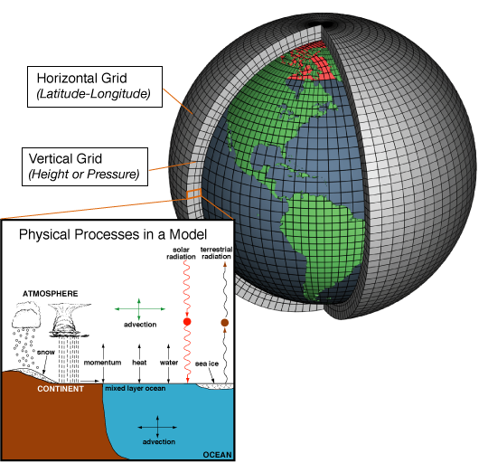

Overview of Climate Projections
Computer-based simulations using mathematical formulas to re-create the physical processes
61 models from 27 groups
Only some have been downscaled
Image Source: NOAA https://celebrating200years.noaa.gov/breakthroughs/climate_model/modeling_schematic.html

Slide 6
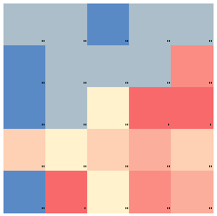
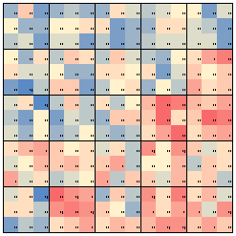
Downscaling Climate Projections
Spatial scale of GCMs are large (~2 °Lat/Lon)
Statistical techniques used to estimate values at finer scales (½ – 8 miles)
  Several methods in practice
  Each have advantages/limitations
  Use observations to relate broader trends

Slide 7
RPA 2020 Assessment
Mandated by Resources Planning Act (RPA)
  Reports status & trends of the Nation's renewable resources on all forests and rangelands
Historic climate observations
5 climate models
2 potential trajectories
9 climate variables
www.fs.fed.us/research/rpa/

Slide 8
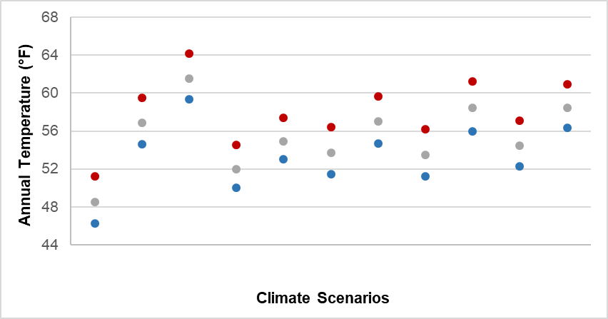
RPA 2020 Assessment
Hot
Warm
Obs
HAD45
HAD85
MRI45
MRI85
CNRM45
CNRM85
IPSL45
IPSL85
NorESM45
NorESM85

Slide 9
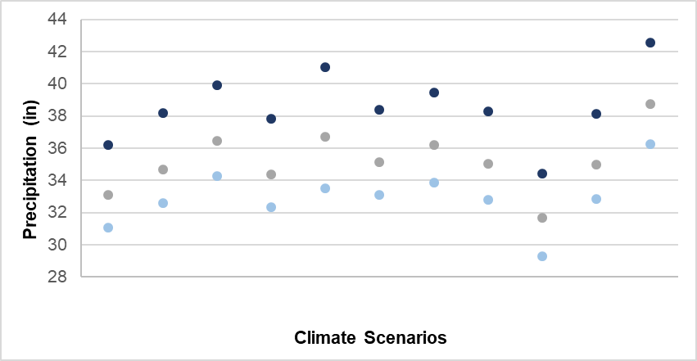
RPA 2020 Assessment
Wet
Dry
Obs
HAD45
HAD85
MRI45
MRI85
CNRM45
CNRM85
IPSL45
IPSL85
NorESM45
NorESM85

Slide 10
Climate Projections
Climate Models
  HadGEM2-ES and IPSL-CM5A-MR
Potential Trajectories
  RCP 4.5 and 8.5
Scenarios
  Warm/Wet (HAD45) & Hot/Wet (HAD85)
  Warm/Dry (IPSL45) & Hot/Dry (IPSL85)

Slide 11
Words of Caution
Projections are based on numerical models
Trajectories estimate GHG emissions, land use change, population dynamics, technological advances
  Exclude policy
Each model contains uncertainty
  More uncertainty associated with precipitation and timing of conditions
Notes:
From Moss et al. 2008: “…the set of underlying socioeconomic scenarios is not intended to span the
range of plausible assumptions for any particular socioeconomic element…”

Slide 12
Climate Indices
Precipitation
  Annual & Seasonal totals
  Annual count of 1” and 2” events
Temperature
  Annual & Seasonal averages
  Seasonal Min, Mean, Max
  Annual count of 0 and 90 °F days

Slide 13
Precipitation Trends - SEMCOG
Precipitation could vary among 30-year periods & by season
  Annually ↑ (2–3”) by end of century
  Spring ↑ (0.2–2”)
  Summer ↓ (0.3–3”)
  Fall little change
  Winter variable among models

Slide 14
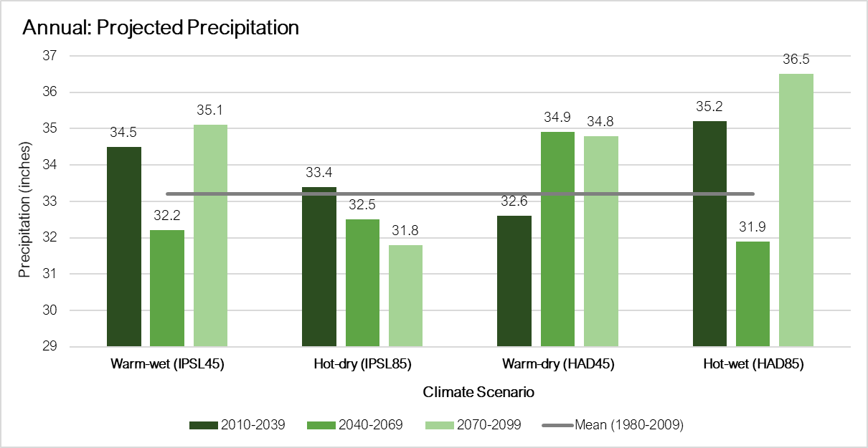

Slide 15
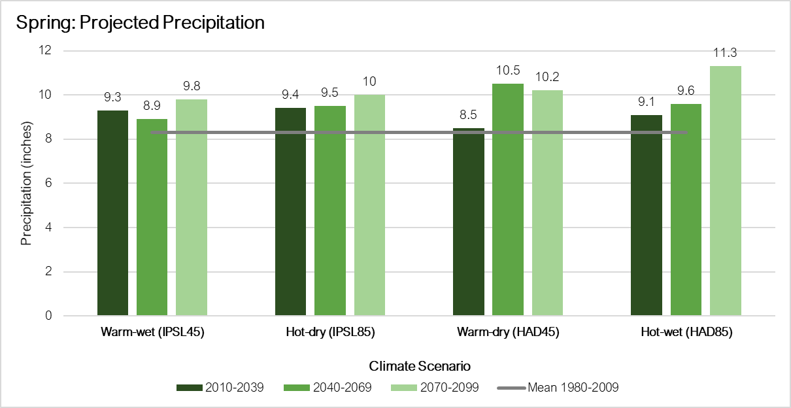

Slide 16
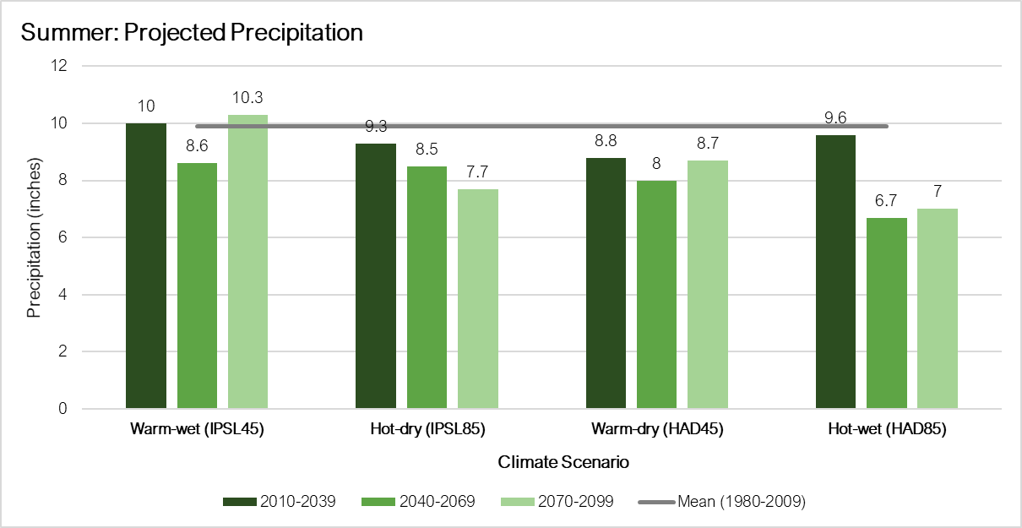

Slide 17
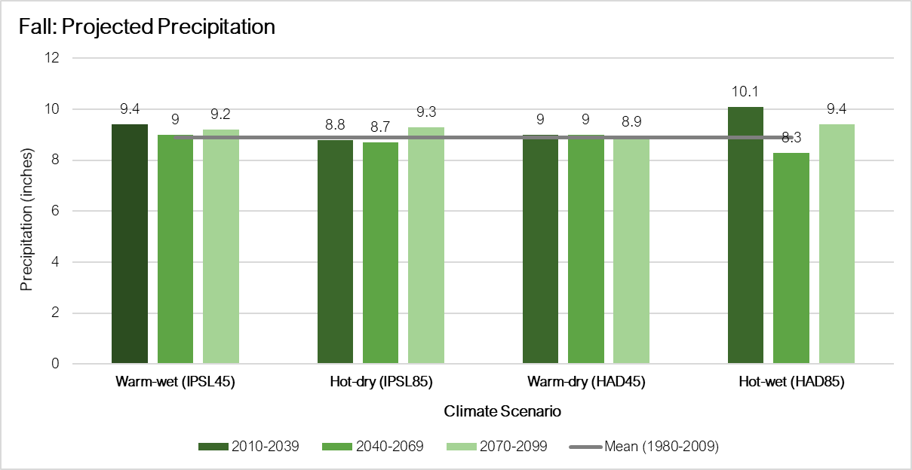

Slide 18
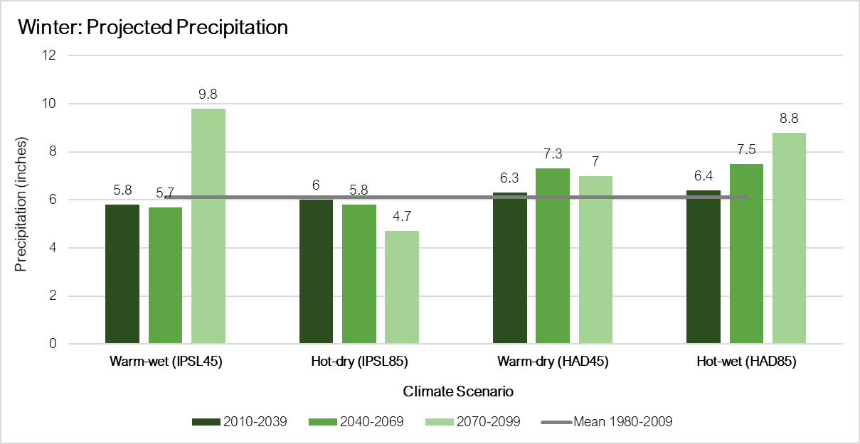
Notes:
Spring and winter could experience increased precipitation, while the summer and fall are projected to decrease or remain the same, respectively, but warmer temperatures could result in more stress for vegetation.

Slide 19
Precipitation Trends - SEMCOG
Precipitation could vary among 30-year periods & by season
Slight increase in 1” & 2” events
  From 3.3 to 3.5 – 5.2 days
  From 0.2 to 0.3 – 0.6 days
Notes:
2” events: 0.2 days = 6 days during a 30-year period
0.6 = 18 days during a 30-year period

Slide 20
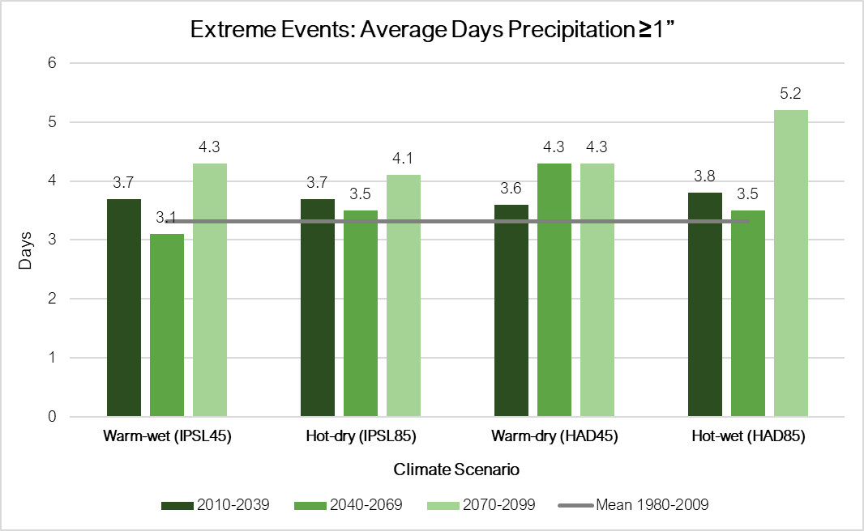
Notes:
Baseline = 3.2 days

Slide 21
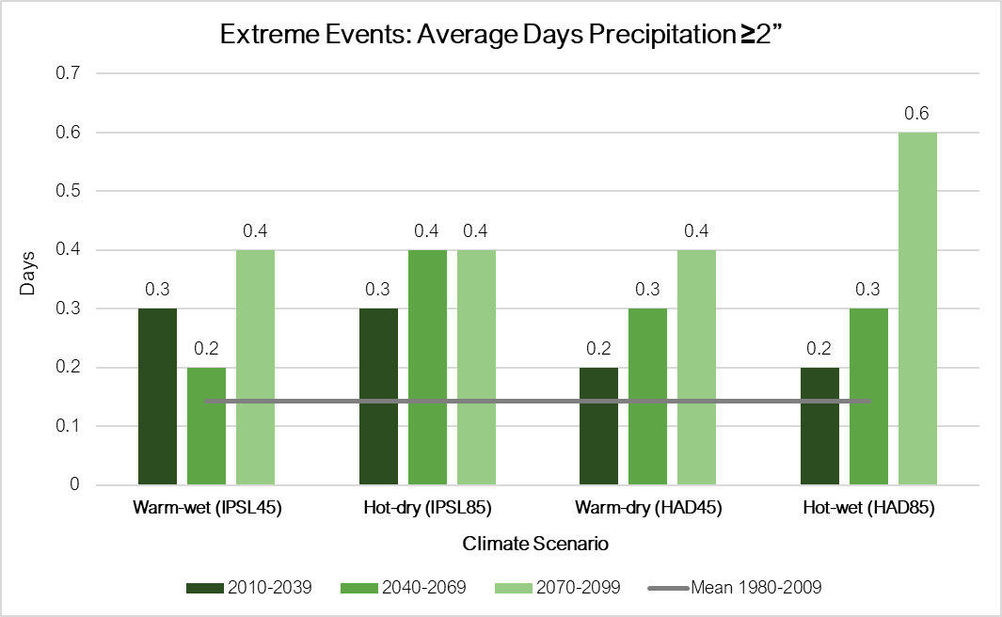
Notes:
Baseline = 0.1 days; average of 0.2 days = 6 days over 30 years

Slide 22
Temperature Trends - SEMCOG
Temperature projections indicate consistent warming during century
  Annually ↑ 2.4 to 13 °F
  Seasonally ↑ 1.4 to 14.5 °F

Slide 23
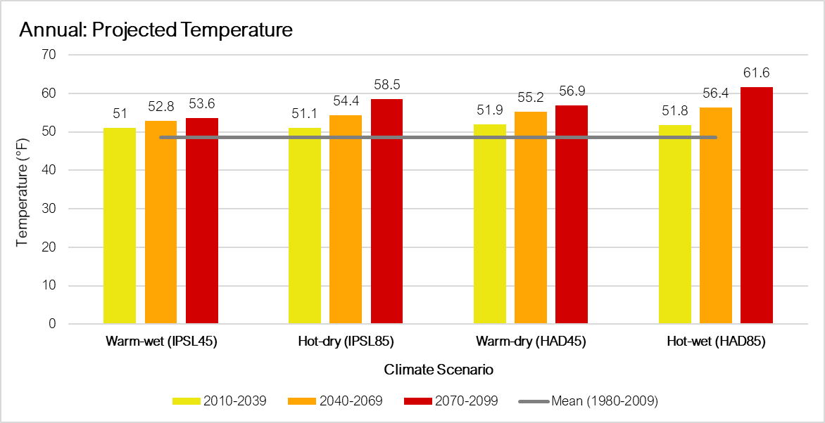

Slide 24
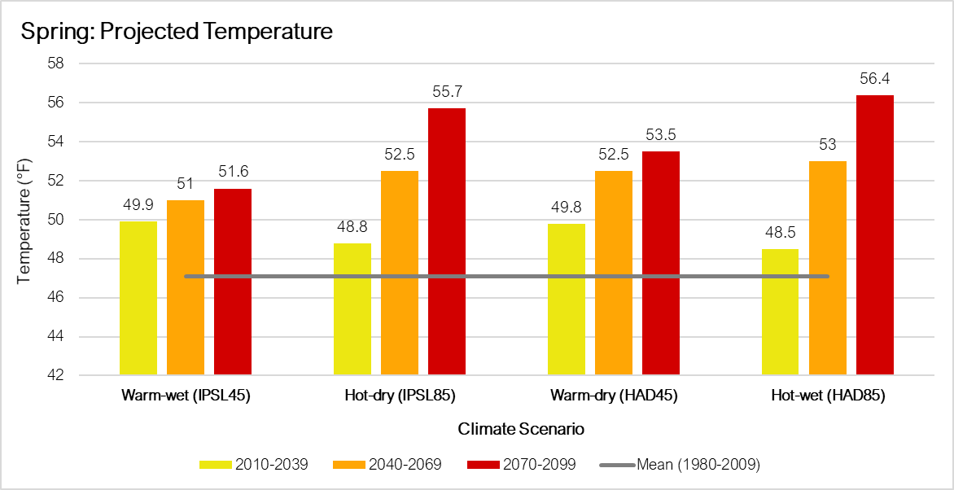

Slide 25
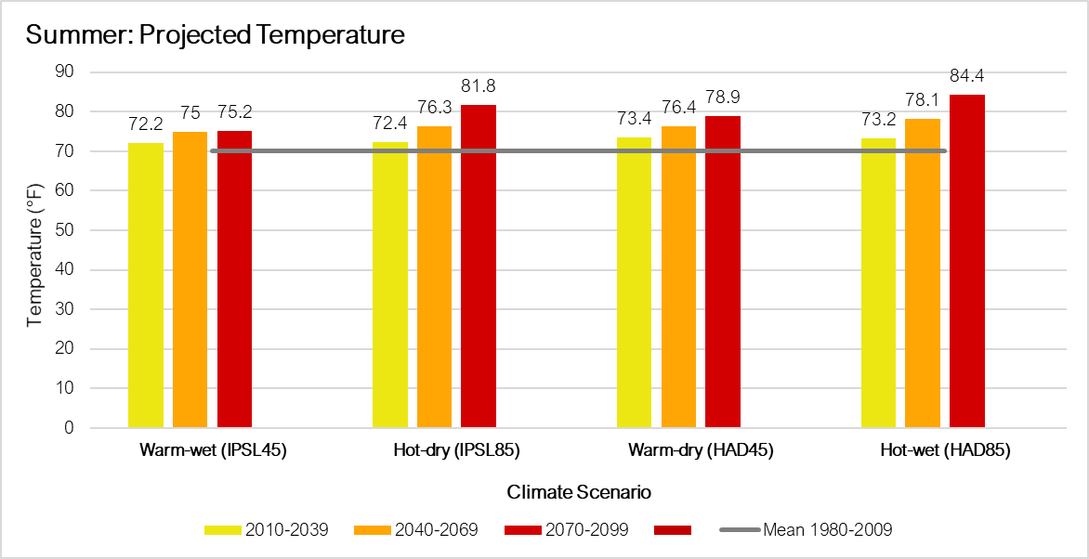

Slide 26
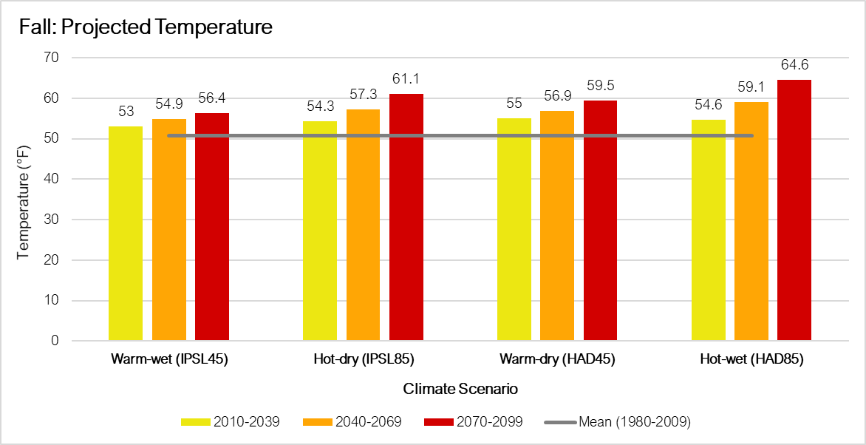

Slide 27
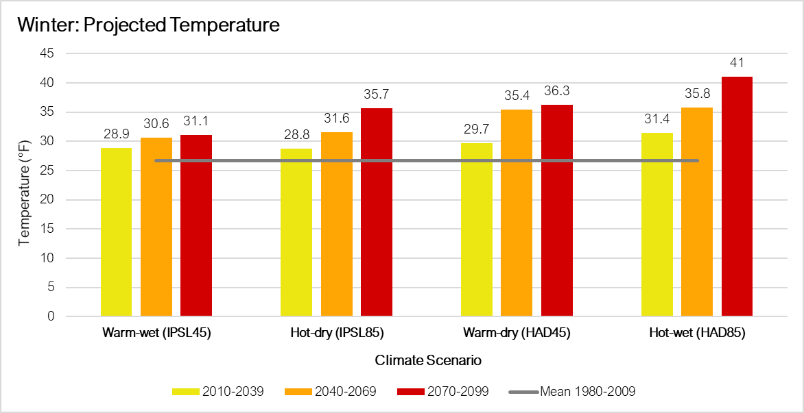
Notes:
Summer precipitation is projected to decrease from the baseline and coupled with warmer temperatures could lead to more droughts
Warmer winter temperatures would likely result in more precipitation occurring as rain rather than snow

Slide 28
Temperature Trends - SEMCOG
Temperature projections indicate consistent warming during century
  Annually ↑ 2.4 to 13 °F
  Seasonally ↑ 1.4 to 14.5 °F
Fewer days below 0 °F (↓ 2 – 4)
More days above 90 °F (↑ 7.6 – 78.9)

Slide 29
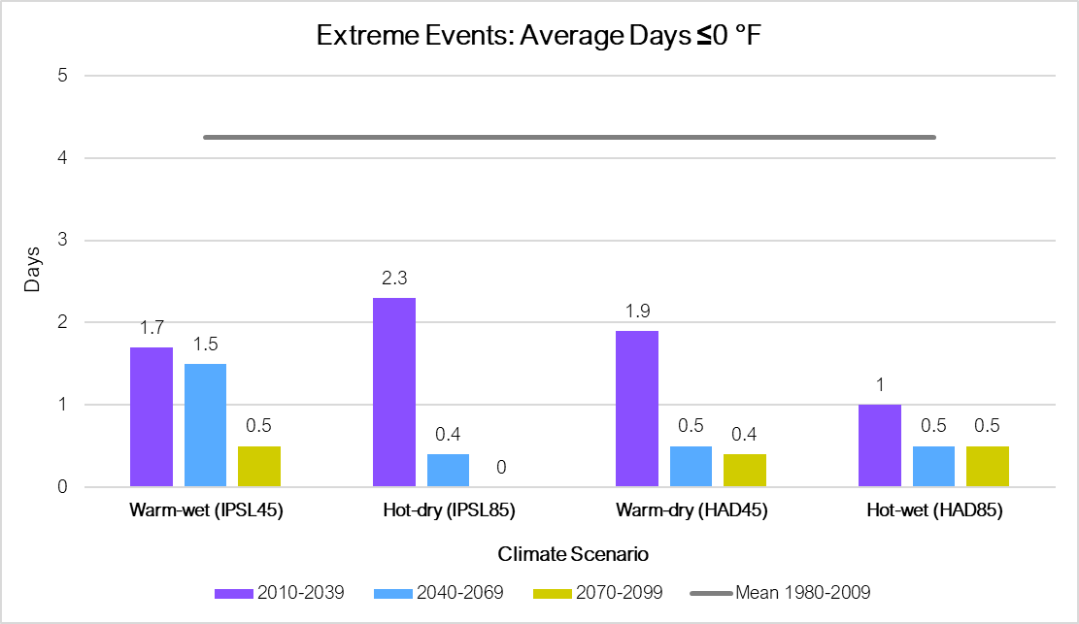

Slide 30
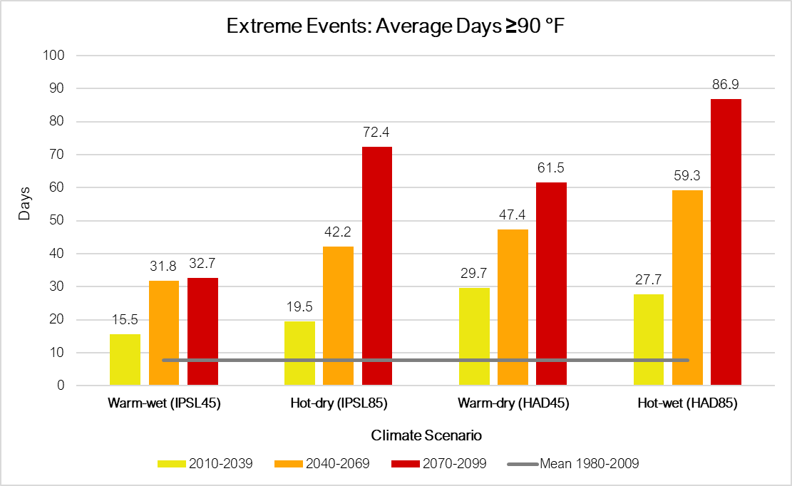

Slide 31
Climate Projection Summaries
Demo
Notes:
Graphs were developed for the seven-county region, but data has been made available for each county.

Slide 32
Questions?
Matt Peters: matthew.p.peters@usda.gov

